Slide 1


Slide 2


Slide 3
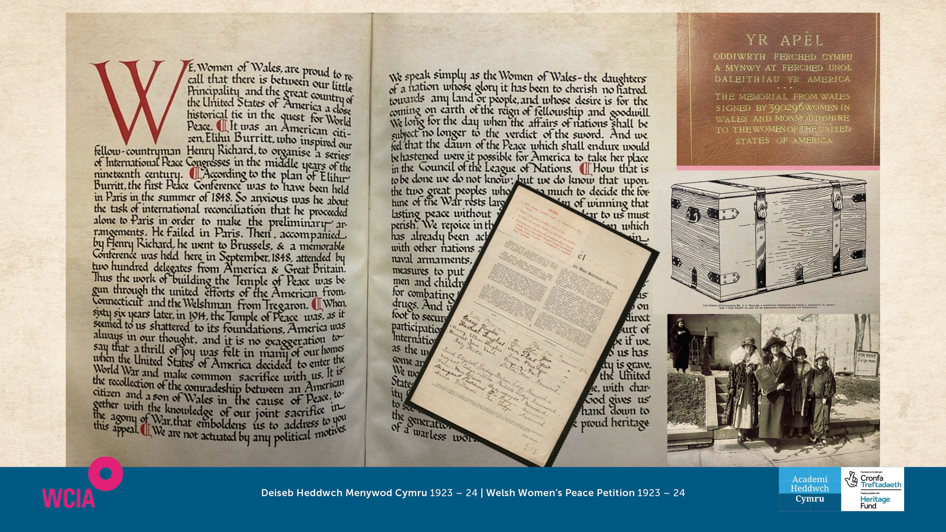

Slide 4
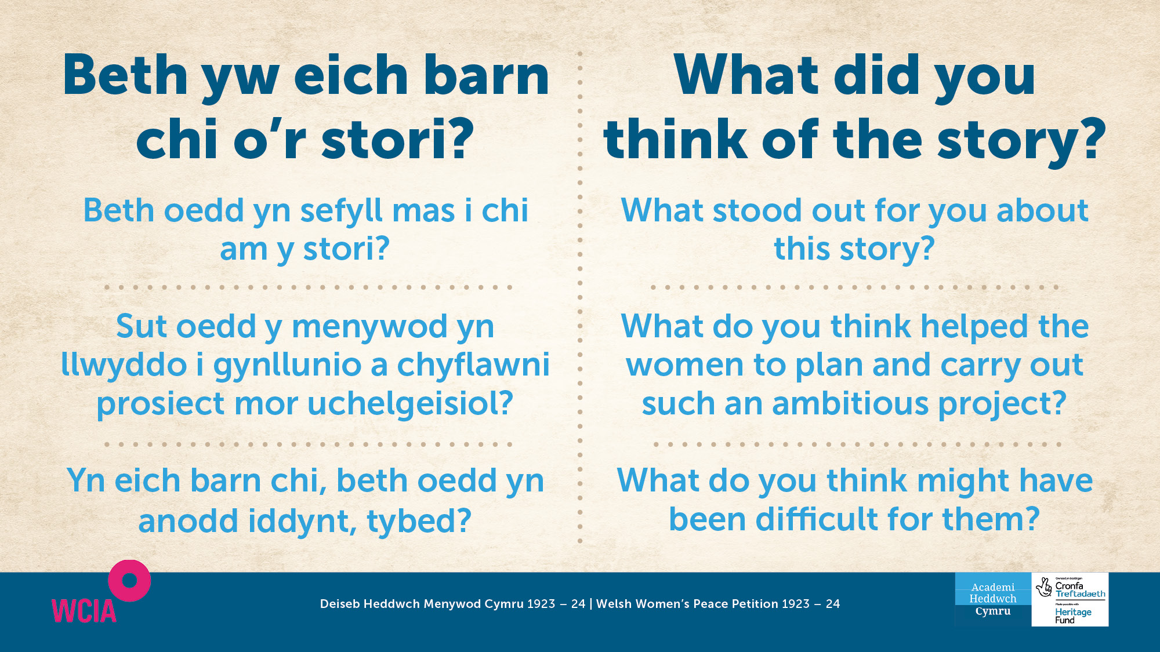

Slide 5

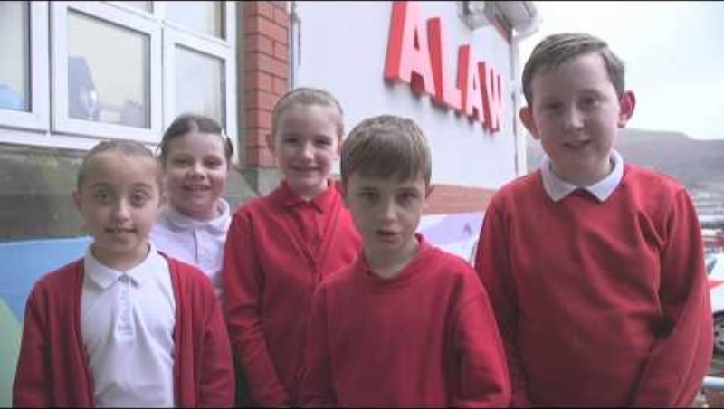

Slide 6
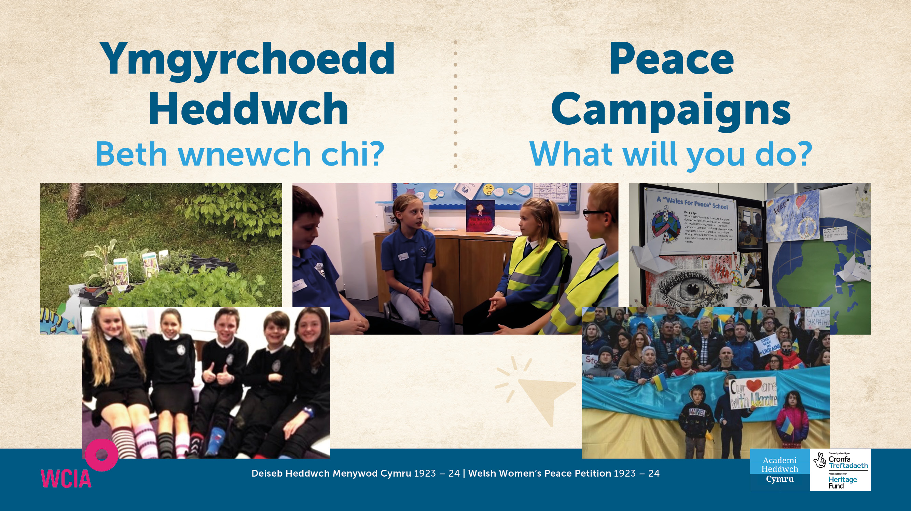
    www.wcia.org.uk/global-learning/peace-schools-in-wales ​

Slide 7


Slide 8


Slide 9

