Slide 1


Slide 2
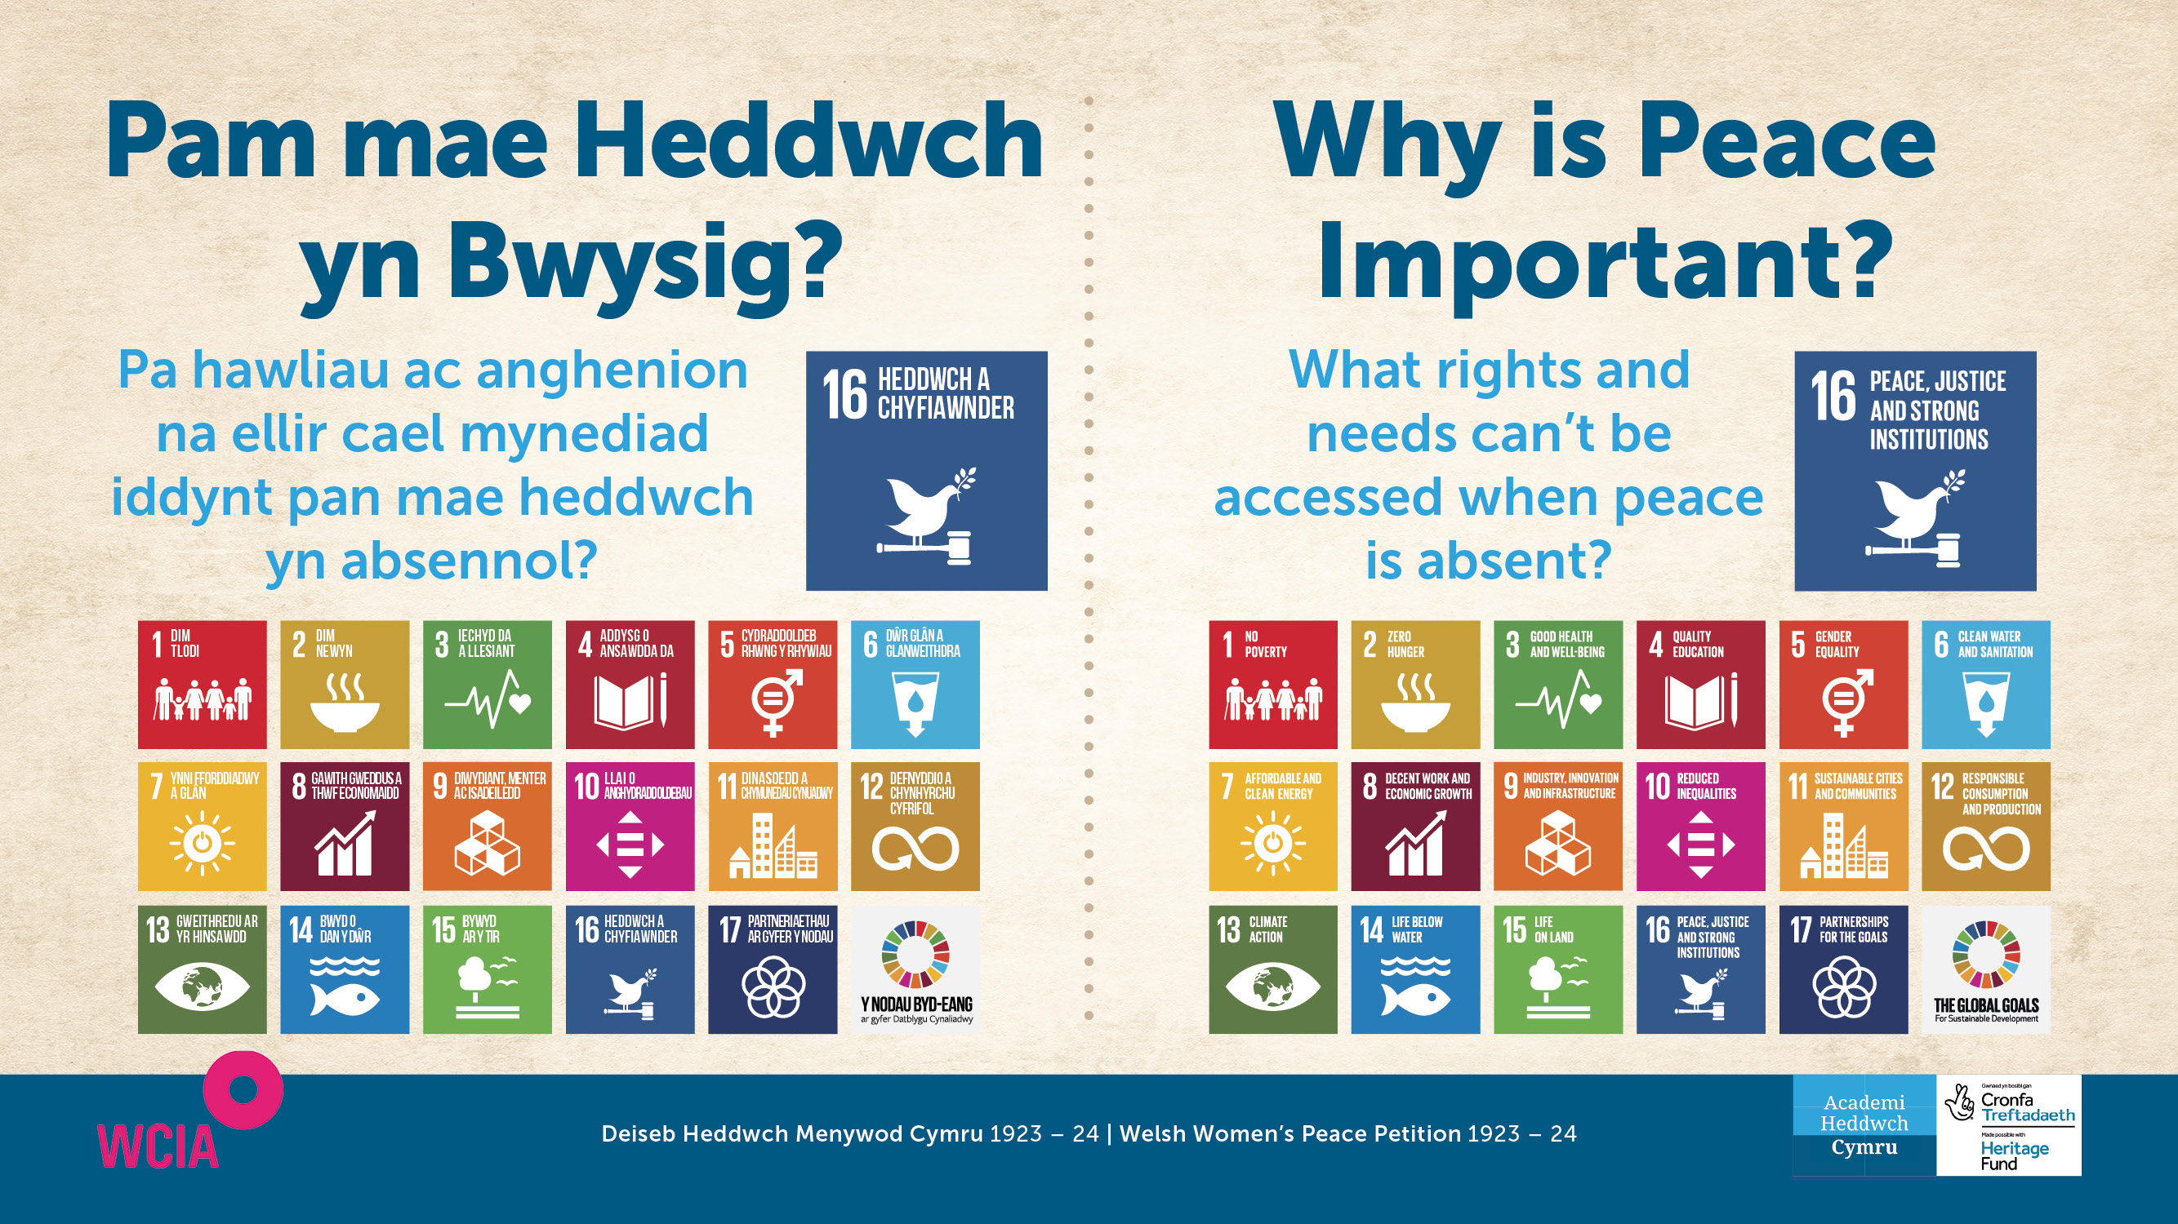

Slide 3
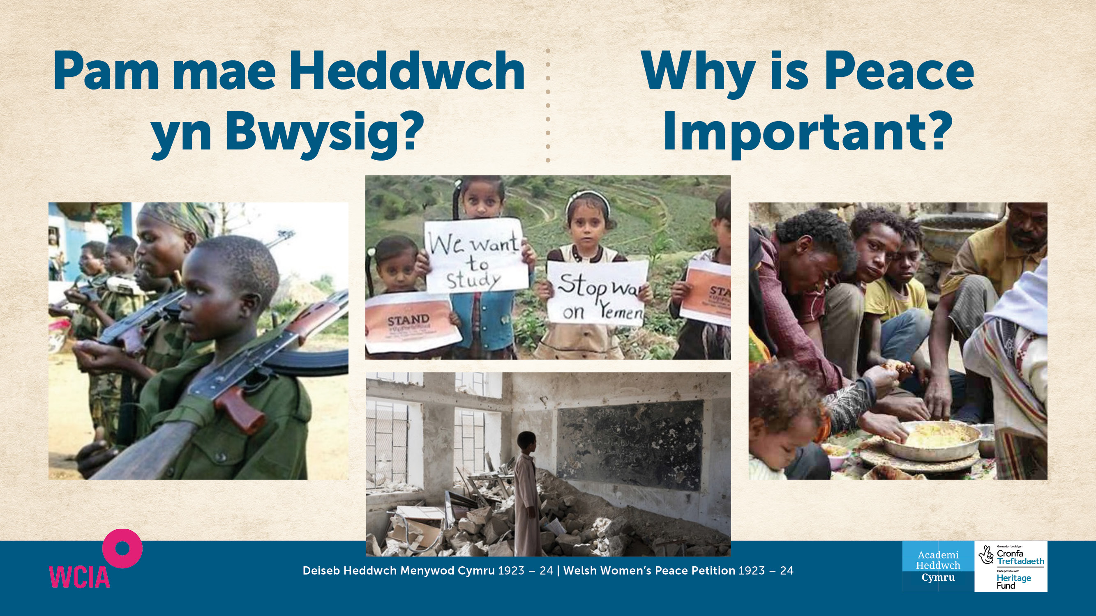

Slide 4


Slide 5
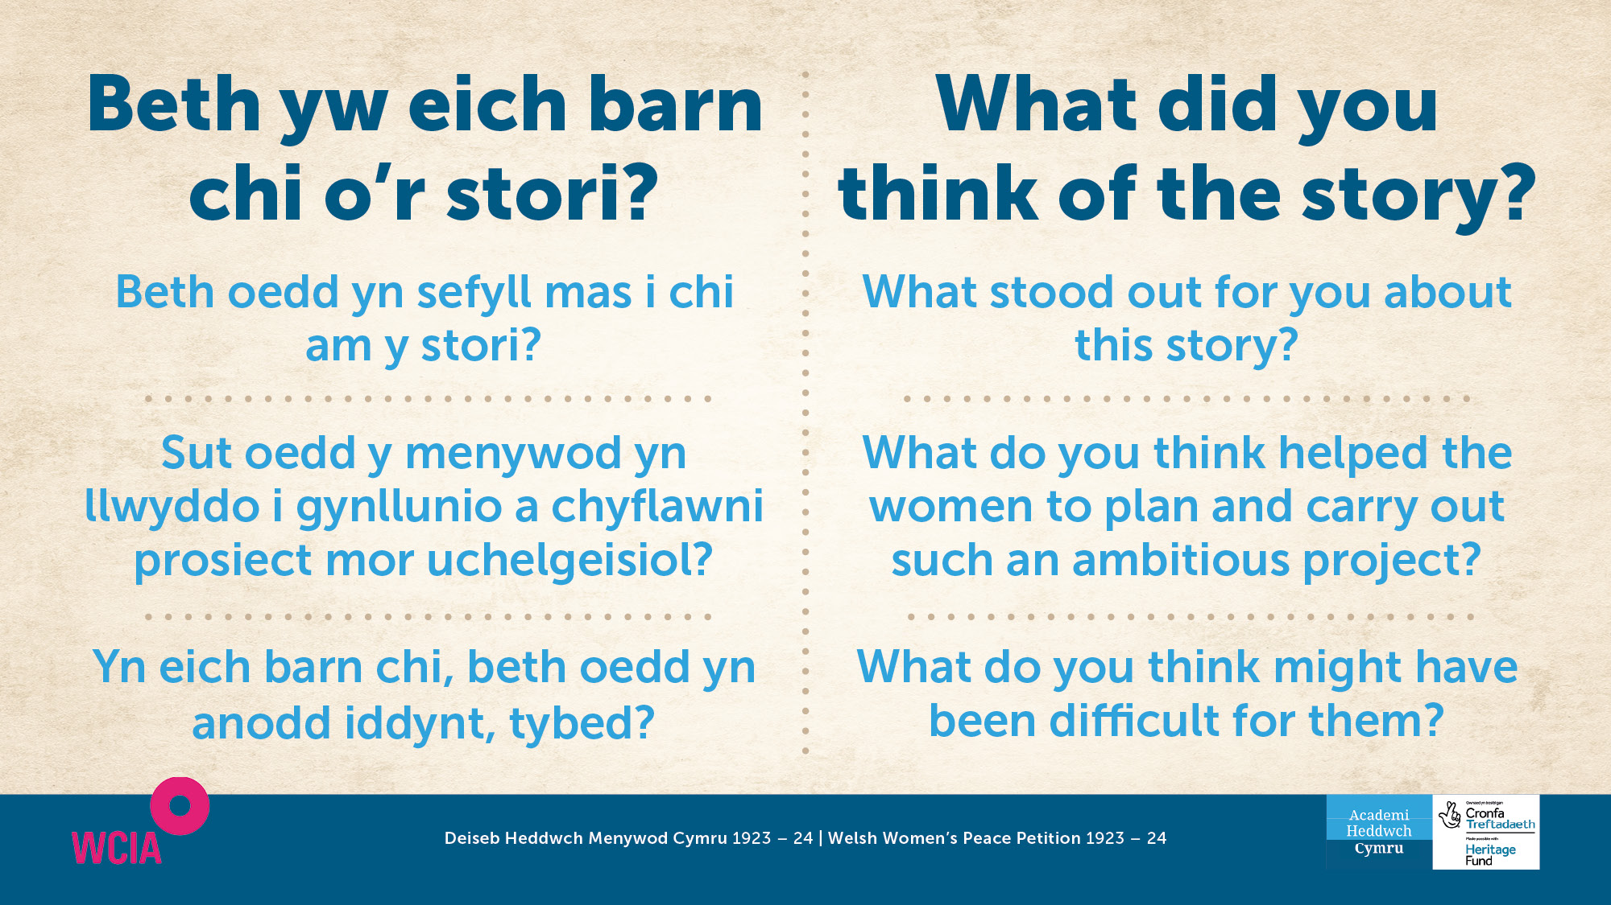

Slide 6


Slide 7
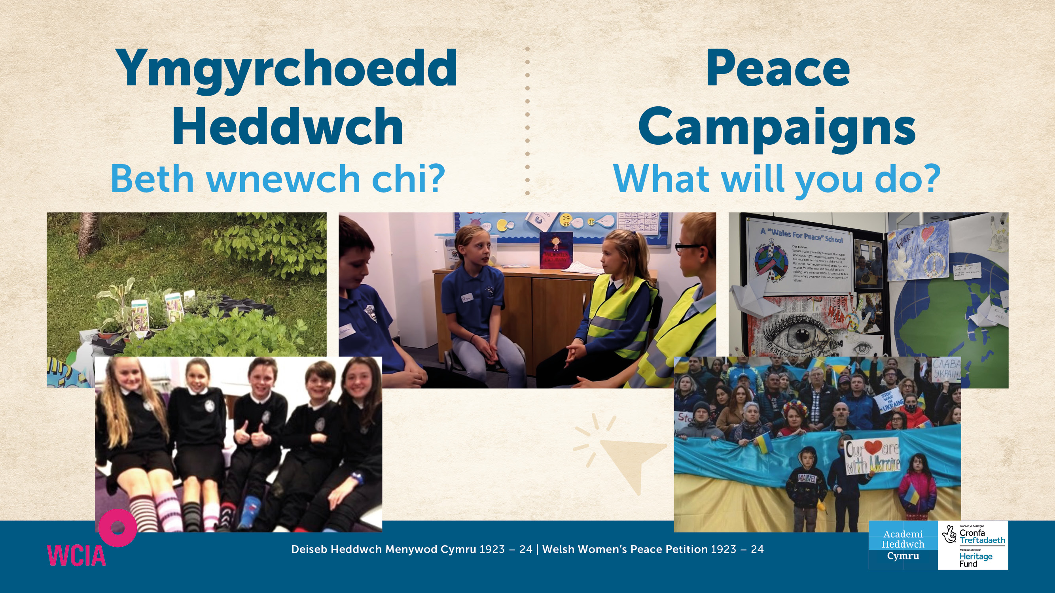
www.wcia.org.uk/global-learning/peace-schools-in-wales ​

Slide 8


Slide 9


Slide 10


