Slide 1

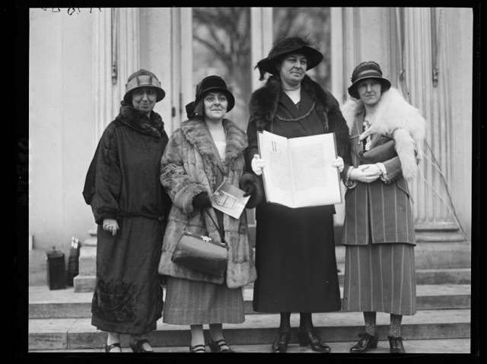






Deiseb Heddwch Menywod Cymru
The Welsh Women’s Peace Petition
1923 - 24

Slide 2



Aims / Amcanion​
To introduce a very special story that happened 100 years ago;
To reflect on the story and what it means for us today;
To start planning one thing we can do for peace;
To learn about how we can do some local research.
Cyflwyno stori arbennig a ddigwyddodd 100 mlynedd yn ôl;
Ystyried y stori a’r hyn mae yn ei olygu i ni heddiw;
Dechrau cynllunio un peth fedrwn ni ei wneud dros heddwch;
Dysgu sut i ymgymryd â darn o ymchwil lleol.

Slide 3
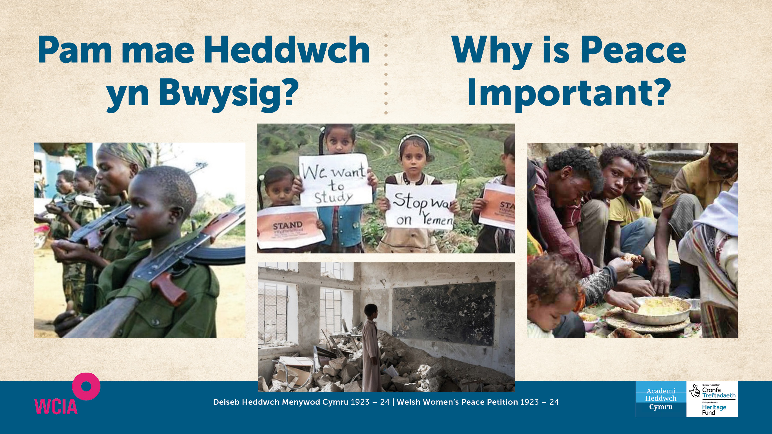

Slide 4
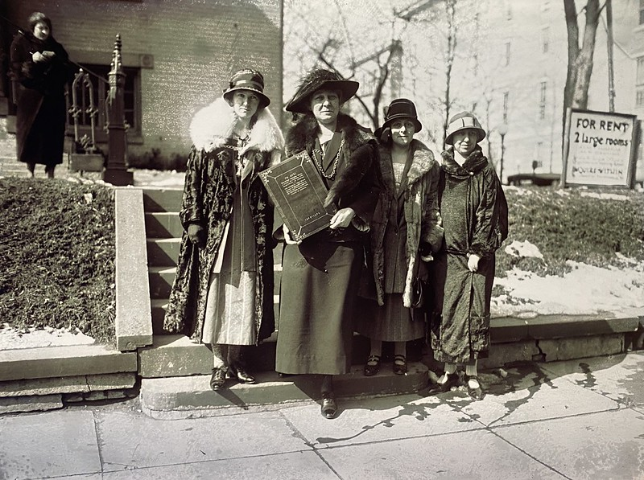
Apêl Heddwch Merched Cymru at Fenywod America Welsh Women’s Peace Appeal to the Women of America 1924
Elined Prys Annie Jane Hughes Griffiths Mary Ellis Gwladys Thomas

Slide 5
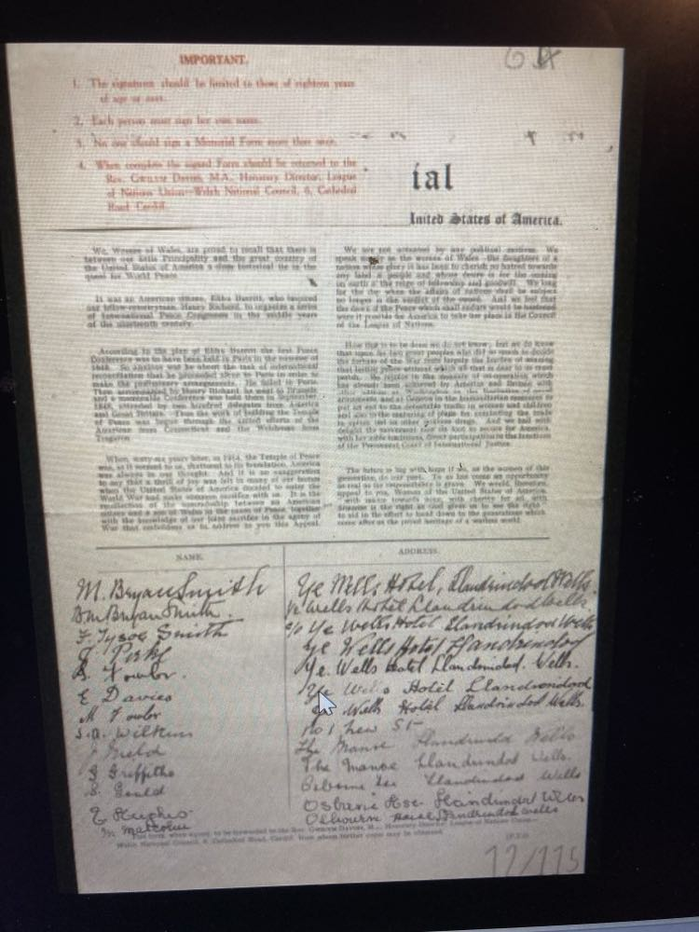
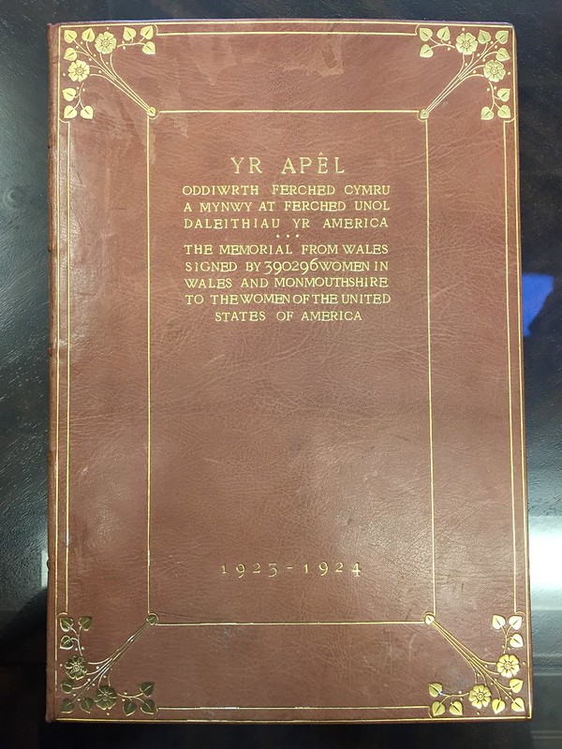
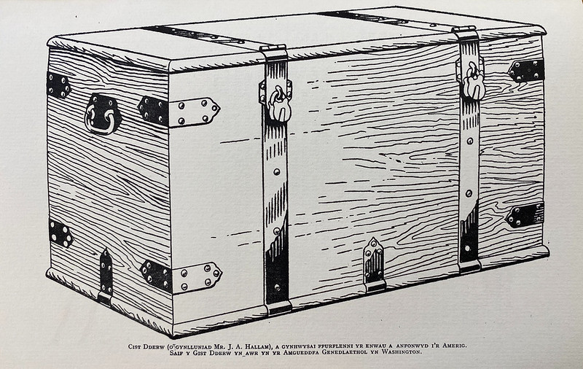
Camp Anhygoel / An Amazing Achievement
390,296 signatures

Slide 6
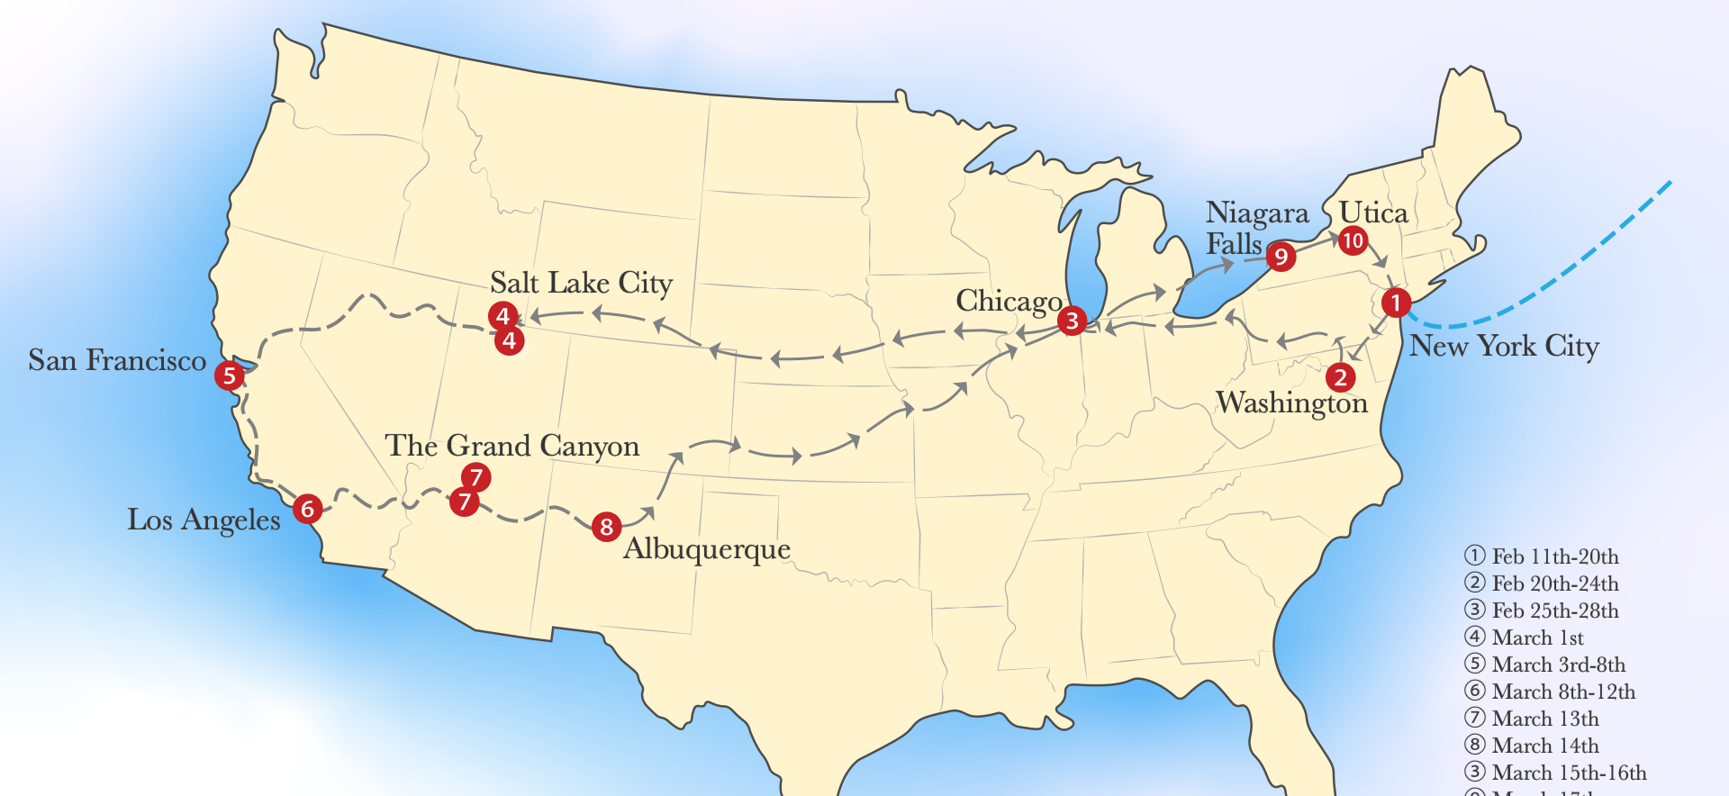
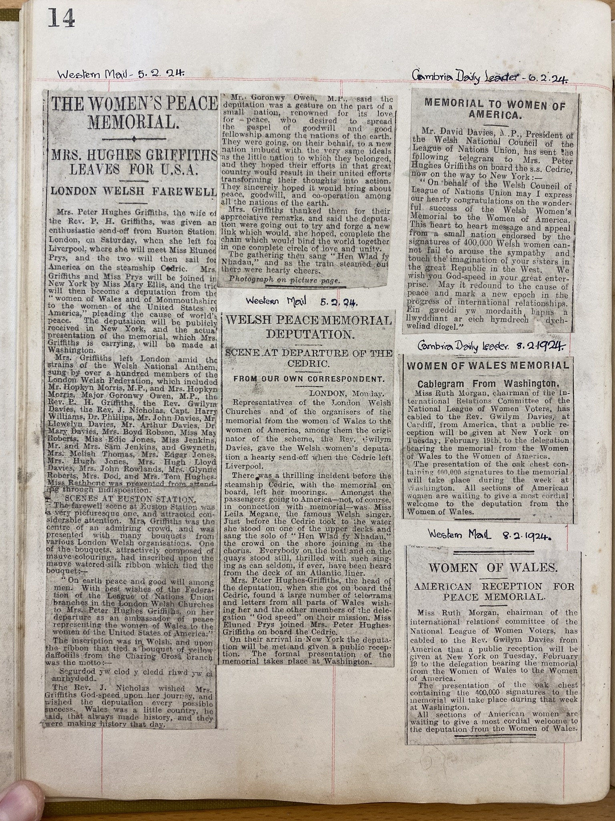
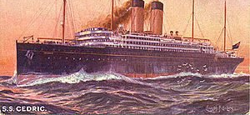
Taith y Menywod The Women’s Journey

Slide 7
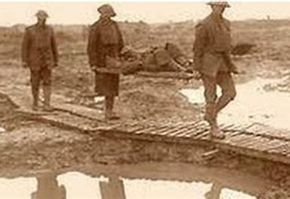

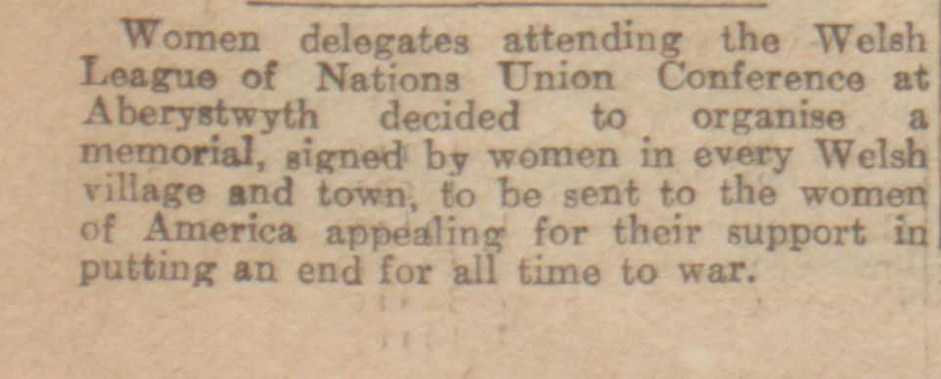
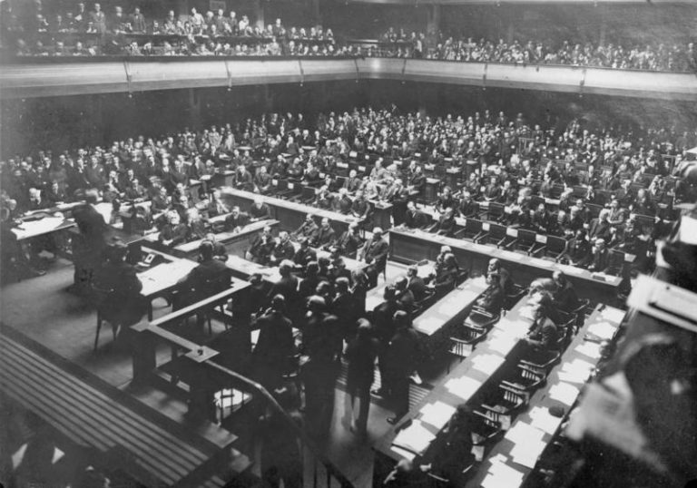


Hedd Nid Cledd/ Law Not War!

Slide 8


Reflecting on the story / Ystyried y stori​
What impressed you most about the story?
What did the women have to do to help them plan and run such a large project?
What obstacles did they face, do you think?
Beth wnaeth yr argraff fwyaf arnoch am y stori?
Beth oedd rhaid i’r menywod ei wneud i gynllunio a rhedeg prosiect mor enfawr?
Pa rhwystrau oedd yn eu hwynebu, yn eich barn chi?
​

Slide 9
Organising a campaign – yesterday and today
Trefnu ymgyrch – ddoe a heddiw
Publicity
Cyhoeddusrwydd
Getting people together / Dod â phobl at ei gilydd
Support
Cefnogaeth
What methods?
Pa ddulliau?

Slide 10
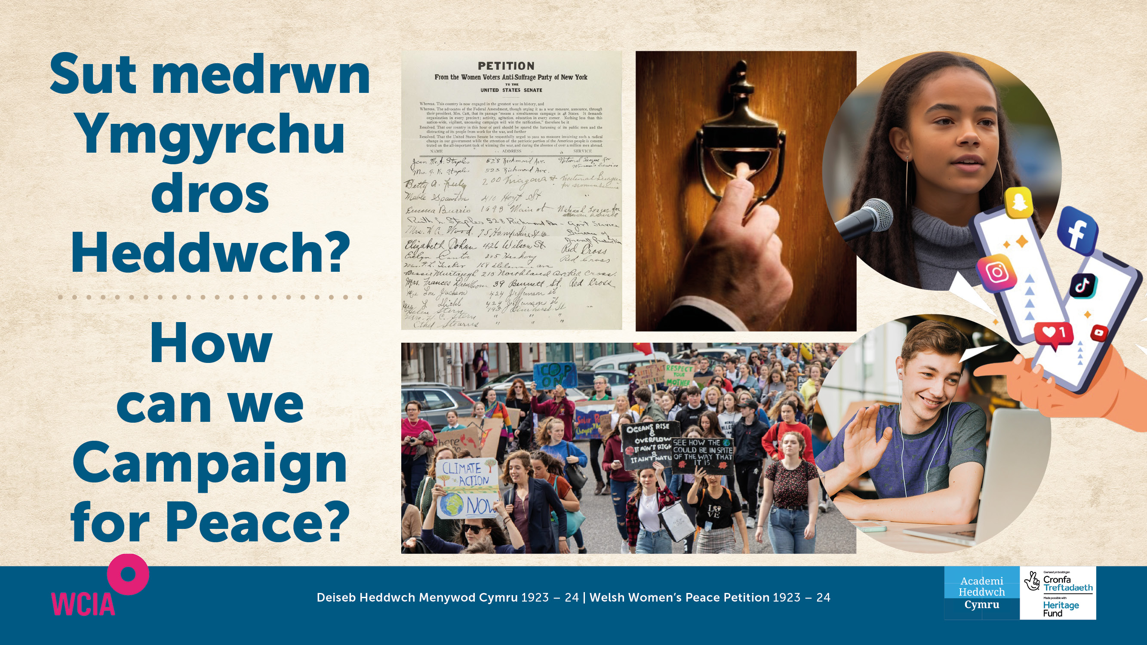

Slide 11

www.wcia.org.uk/global-learning/peace-schools-in-wales ​

Slide 12


Slide 13
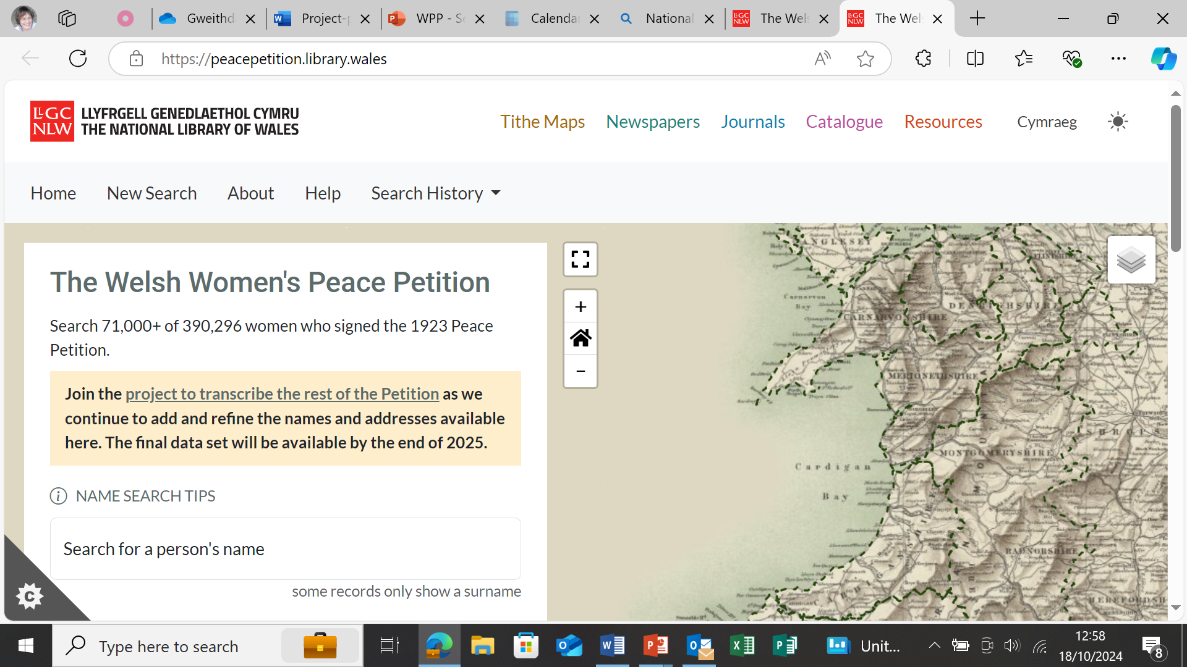
Researching the Petition / Ymchwilio’r Ddeiseb​
https://peacepetition.library.wales/ ​

Slide 14
