Slide 1



Peacebuilding
Adeiladu Heddwch
Peacekeeping
Cadw Heddwch
Peacemaking
Creu Heddwch

Slide 2


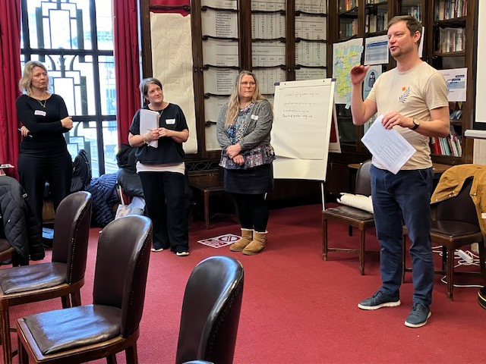





Slide 3
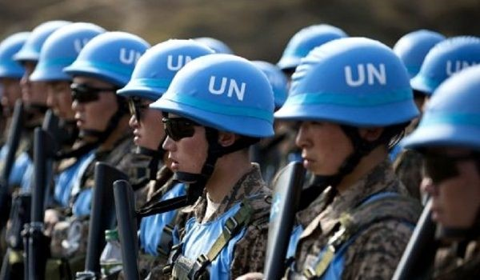

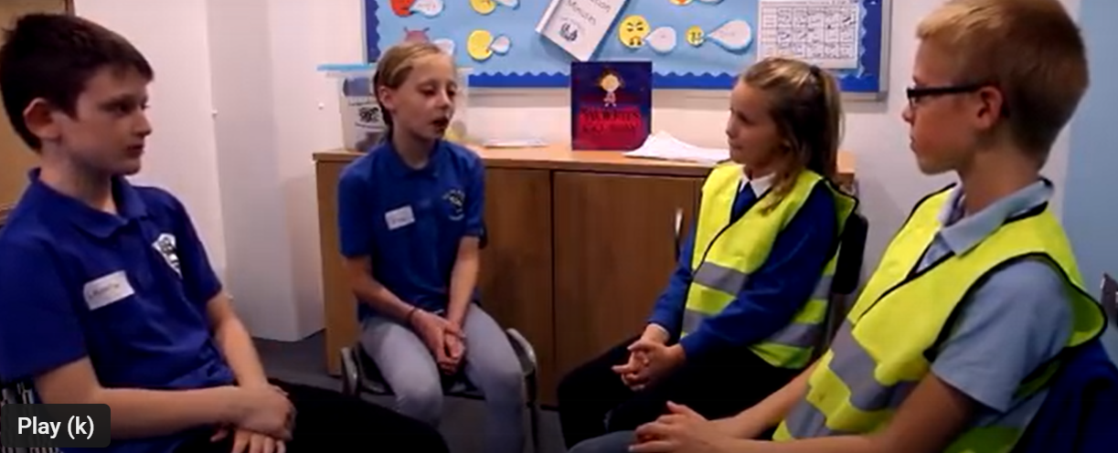


Slide 4
