Slide 1
Changemakers Oasis
February 2026
Nick Christoforou
2025-11-13 00:05:07
--------------------------------------------
@becs.crosby@shofficecomms.co.uk Please view this document. You can also add comments.
Nick Christoforou
2025-11-13 00:05:07
--------------------------------------------
@hello@seanrees.co.uk Please view this document. You can also add comments.
Nick Christoforou
2025-11-13 00:05:07
--------------------------------------------
@HayleyMorgan@wcia.org.uk Please view this document. You can also add comments.
Nick Christoforou
2025-11-13 00:05:07
--------------------------------------------
@craigowen@wcia.org.uk Please view this document. You can also add comments.
Making change happen

Slide 2


Introduction
What is changemakers?
What changes will we make?
Impact and effort
Making a plan
Next steps

Slide 3
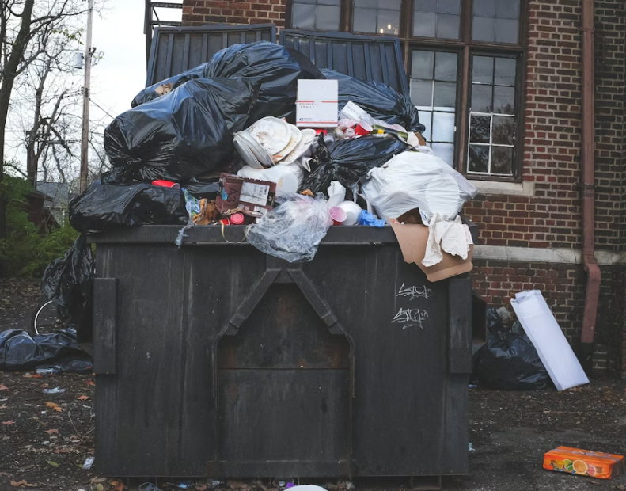
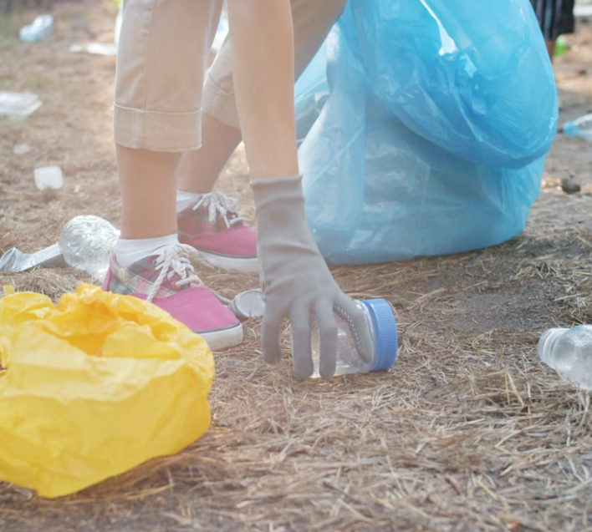
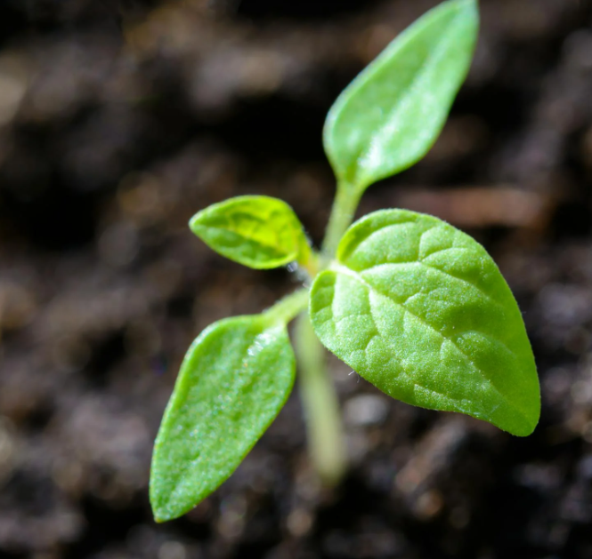
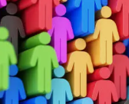
What change is taking place in these images?
Issue
Action
change
Part One
The group decides one issue they think is important
+
=
Better environment
Better community

Slide 4
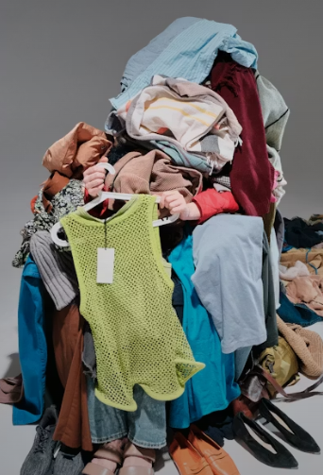
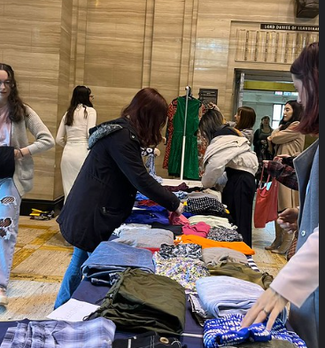
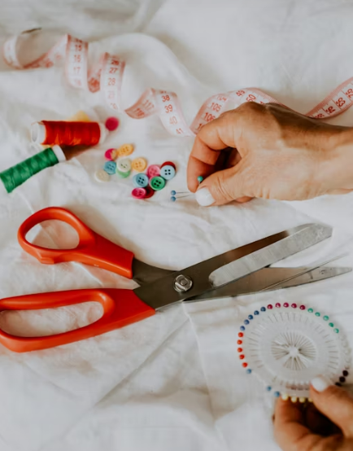
What is making change?
Issue
Action
change
Part One
The group decides one issue they think is important
Better environment
+
=
New skills
Better community

Slide 5

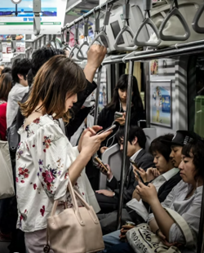
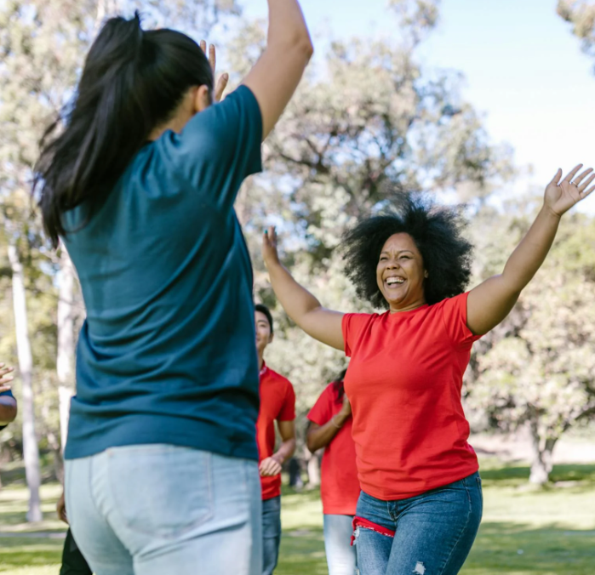
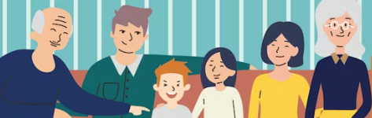

What is making change?
Issue
Action
change
Part One
The group decides one issue they think is important
+
=
Learning games
Happier families
conversations

Slide 6
What is changemakers?
Part One
The group decides one issue they think is important
Part Two
The group agrees the action they can take to change it.
Part Three
The group carries out their agreed action with help from both adults at Oasis and us at Cymru Global.
Part Four
The group comes to the conference in July and tell us what you did!

Slide 7

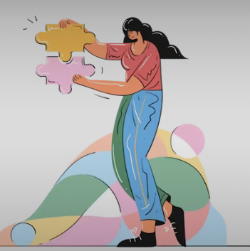
Your turn!
Issue
Action
change
Part One
The group decides one issue they think is important
What change will it make?
+
=
What issue that you can think of to take action on?
Name one action you can take

Slide 8
Effort and impact
Big change
Changing the law so those who don’t litter get in trouble.
Asking your community to put their litter in the bin
Putting your litter in a bin
Small change
Hard
Easy

Slide 9
Where does your action go?
Big change
Small change
Hard
Easy

Slide 10
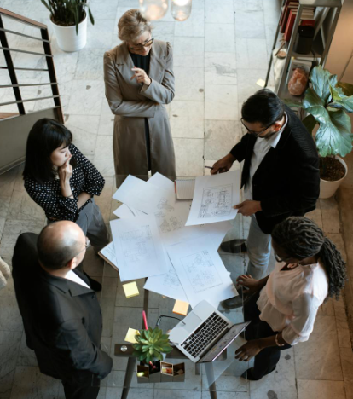
Making a plan
Now you know your activity, it’s time to start making a plan on how to do it.
Choose one person in your group to write things down and then start deciding:
What activity do you want to do?
When should it be? And where?
What will you need to carry it out?
How will you promote your event?

