Slide 1
Nick Christoforou
2025-11-13 00:05:07
--------------------------------------------
@becs.crosby@shofficecomms.co.uk Please view this document. You can also add comments.
Nick Christoforou
2025-11-13 00:05:07
--------------------------------------------
@hello@seanrees.co.uk Please view this document. You can also add comments.
Nick Christoforou
2025-11-13 00:05:07
--------------------------------------------
@HayleyMorgan@wcia.org.uk Please view this document. You can also add comments.
Nick Christoforou
2025-11-13 00:05:07
--------------------------------------------
@craigowen@wcia.org.uk Please view this document. You can also add comments.
Exploring Global Citizenship and gender
.

Slide 2
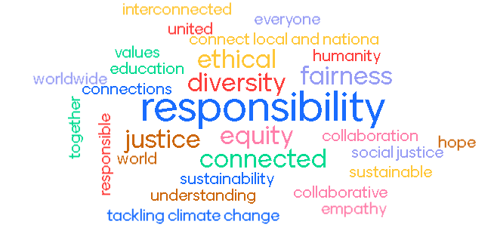


What words come to mind when you think of global citizenship?

Slide 3


What words come to mind when you think of global citizenship?
’Global citizenship is the umbrella term for social, political, environmental, and economic actions of globally minded individuals and communities on a worldwide scale…
Global citizenship is embedded in the Sustainable Development Goals through SDG4: Quality Education
The United Nations
In Wales:
Wellbeing for Future Generations Act
Globally responsible Wales wellbeing goal Indicator
Public Health Wales’s International Health Strategy

Slide 4
Knowledge & Understanding | Skills | Values & attitudes
Social Justice & Equity | Critical and creative thinking | Sense of identity and self esteem
Identity & Diversity | Empathy | Commitment to social justice and equity
Globalisation & Interdependence | Self-Awareness and reflection | Respect for people and human rights
Sustainable Development | Communication | Value Diversity
Peace & conflict | Cooperation & conflict resolution | Concern for the environment
Human Rights | Managing complexity & uncertainty | Commitment to inclusion and participation
Power & Governance | Informed & reflective decision making | Belief that people can bring about change
Oxfam’s global citizenship framework
Notes:
Around the world there is a growing recognition of the fundamental importance of educating for global citizenship because: • All learners need a safe space in which to explore complex and controversial global issues they encounter through the media and their own experiences, and school can provide this. Even very young children are already trying to make sense of a world marked by division, conflict, environmental change, inequality and poverty. • It has a critical role to play in equipping a generation with the vision and means to rise to complex challenges that transcend national borders. • We live in an increasingly globalised and interconnected world in which the global is part of our everyday lives, and analysis of seemingly local issues benefits from global perspectives. • Research (for example, by Think Global) and our own work in schools have shown the demand from learners
A full break down of skills, knowledge and attitudes can be found here edu-global-citizenship-schools-guide-091115-en.pdf (openrepository.com)

Slide 5
Using pronouns
What do we expect from the different gender roles? Is this the same across the world?
He/his
What do you expect from a “male” gender role?
She/hers
What do you expect from a “female” gender role?
They/them
What do you expect from a non-binary gender role?
Notes:
Do you think these expectations are the same across the world?
Take a look at our gender quiz to see some of the statistics about how they are treated

Slide 6
Citizenship in practice
Imagine that, overnight, all of the world’s women/men disappear. What would the consequences be for:
Politics
Transport
Families
Crime and enforcement
The media
International relations
Do you think this would be the same in all countries?

Slide 7
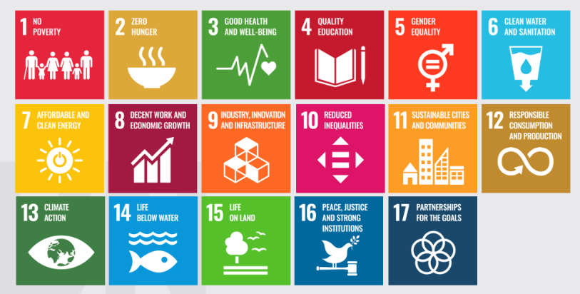
Looking at the Sustainable Development Goals, how many of these themes did you touch on?
Sustainable Development and gender
Notes:
The SDGs outline the goals we are all working on towards 2030. The top line refers to societal equity, the middle refers to cultural infrastructure, the third around nature and populations. A crisis like the one we have outlined takes from all three aspects and, to fix it, we have to pay attention to how we tackle them better.

