Slide 1
Nick Christoforou
2025-11-13 00:05:07
--------------------------------------------
@becs.crosby@shofficecomms.co.uk Please view this document. You can also add comments.
Nick Christoforou
2025-11-13 00:05:07
--------------------------------------------
@hello@seanrees.co.uk Please view this document. You can also add comments.
Nick Christoforou
2025-11-13 00:05:07
--------------------------------------------
@HayleyMorgan@wcia.org.uk Please view this document. You can also add comments.
Nick Christoforou
2025-11-13 00:05:07
--------------------------------------------
@craigowen@wcia.org.uk Please view this document. You can also add comments.
Exploring Global Citizenship and stress
.

Slide 2
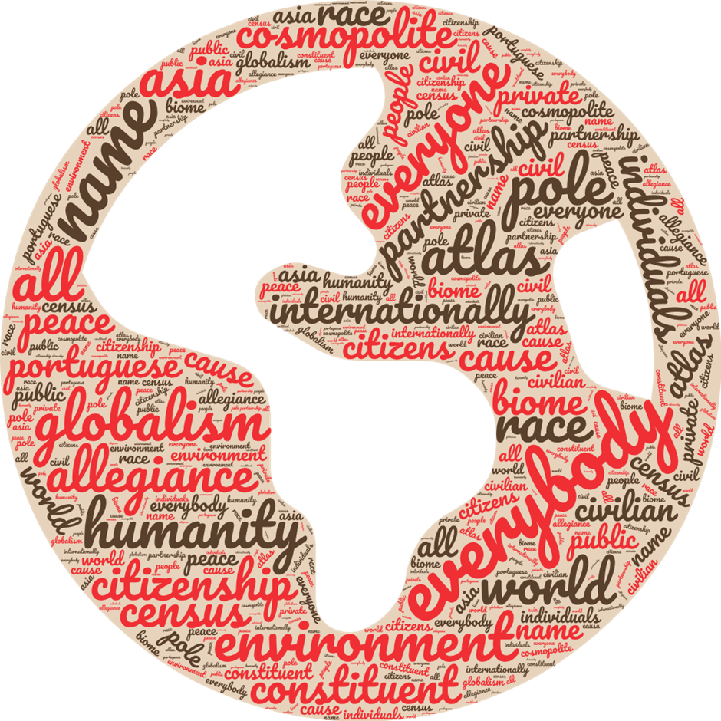


What words come to mind when you think of global citizenship?
You might find it helpful to think of what attitudes you think it comes with, or what skills, or what kind of knowledge
Notes:
Global citizenship is a term used to describe the social, environmental, and economic actions taken by individuals and communities who recognise that every person is a citizen of the world.
It is about how decisions in one part of the planet can affect people living in a different part of it, and about how we all share a common humanity and are of equal worth.
It means being open to engaging positively with other identities and cultures and being able to recognise and challenge stereotypes.
It is also about how we use and share the earth's resources fairly and uphold the human rights of all

Slide 3
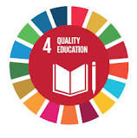

Global citizenship in Wales and the World
’Global citizenship is the umbrella term for social, political, environmental, and economic actions of globally minded individuals and communities on a worldwide scale…
Global citizenship is embedded in the Sustainable Development Goals through SDG4: Quality Education
The United Nations
In Wales:
Wellbeing for Future Generations Act
Globally responsible Wales wellbeing goal Indicator
Public Health Wales’s International Health Strategy

Slide 4
Knowledge & Understanding | Skills | Values & attitudes
Social Justice & Equity | Critical and creative thinking | Sense of identity and self esteem
Identity & Diversity | Empathy | Commitment to social justice and equity
Globalisation & Interdependence | Self-Awareness and reflection | Respect for people and human rights
Sustainable Development | Communication | Value Diversity
Peace & conflict | Cooperation & conflict resolution | Concern for the environment
Human Rights | Managing complexity & uncertainty | Commitment to inclusion and participation
Power & Governance | Informed & reflective decision making | Belief that people can bring about change
Oxfam’s global citizenship framework
Notes:
Around the world there is a growing recognition of the fundamental importance of educating for global citizenship because: • All learners need a safe space in which to explore complex and controversial global issues they encounter through the media and their own experiences, and school can provide this. Even very young children are already trying to make sense of a world marked by division, conflict, environmental change, inequality and poverty. • It has a critical role to play in equipping a generation with the vision and means to rise to complex challenges that transcend national borders. • We live in an increasingly globalised and interconnected world in which the global is part of our everyday lives, and analysis of seemingly local issues benefits from global perspectives. • Research (for example, by Think Global) and our own work in schools have shown the demand from learners
A full break down of skills, knowledge and attitudes can be found here edu-global-citizenship-schools-guide-091115-en.pdf (openrepository.com)

Slide 5

Investigating stress
Stress can be defined as a state of worry or mental tension caused by a difficult situation. Stress is a natural human response that prompts us to address challenges and threats in our lives. Stress affects both the mind and the body. A little bit of stress is good and can help us perform daily activities. Too much stress can cause physical and mental health problems. The World Health Organisation
Stress is the body's reaction to feeling threatened or under pressure.
When we are stressed, our body releases a hormone called adrenaline (often called the "fight or flight" hormone), which usually gives us a boost or motivates us to act quickly.
But too much stress can affect our mood, our body and our relationships – especially when it feels out of our control. It can make us feel anxious and irritable, and affect our self-esteem.
Experiencing long-term stress or severe stress can lead to feeling physical, mental and emotional exhaustion, often called "burnout"
Notes:
Why do you think people are generally feeling more stressed now than they used to be?

Slide 6
Stress around the world
Who do you think are the least and most stressed in our world today?
Least stressed countries | Most stressed countries
Notes:
CEOWORLD’s 2025 Global Emotions Report
Important Considerations
Data limitations: Reporting and diagnosis vary widely across countries. Lower-income or developing nations may appear to have lower rates simply due to limited mental health infrastructure and underdiagnosis World Population ReviewEmpowHER.
Work-related stress Factors like job insecurity, long hours, work-life imbalance
Money-related stress Financial instability, living costs, debt concerns
Social & family stress Pressures within relationships, community expectations
Health & safety stress Public health access, crime, environmental and political safety
Additional Notes
While CEOWORLD clearly specifies the four pillars, they do not publicly disclose the exact weighting of each category—i.e., how much each dimension contributes to the total stress score—nor the precise scoring formulas or data sources for underlying metrics CEOWORLDBusiness Insider Africa.
The data collection appears to include both survey components (covering emotional stress experiences) and possibly objective indicators (such as public health and safety measures), though the methodology blending these elements isn’t detailed in public documentation

Slide 7
Stress around the world
Who do you think are the least and most stressed in our world today?
Least stressed countries | Most stressed countries
1. Monaco
2. Liechtenstein
3. Luxembourg
4. Switzerland
5. Ireland
Notes:
CEOWORLD’s 2025 Global Emotions Report
Important Considerations
Data limitations: Reporting and diagnosis vary widely across countries. Lower-income or developing nations may appear to have lower rates simply due to limited mental health infrastructure and underdiagnosis World Population ReviewEmpowHER.
Work-related stress Factors like job insecurity, long hours, work-life imbalance
Money-related stress Financial instability, living costs, debt concerns
Social & family stress Pressures within relationships, community expectations
Health & safety stress Public health access, crime, environmental and political safety
Additional Notes
While CEOWORLD clearly specifies the four pillars, they do not publicly disclose the exact weighting of each category—i.e., how much each dimension contributes to the total stress score—nor the precise scoring formulas or data sources for underlying metrics CEOWORLDBusiness Insider Africa.
The data collection appears to include both survey components (covering emotional stress experiences) and possibly objective indicators (such as public health and safety measures), though the methodology blending these elements isn’t detailed in public documentation

Slide 8
Stress around the world
Who do you think are the least and most stressed in our world today?
Least stressed countries | Most stressed countries
1. Monaco | 1. Burundi
2. Liechtenstein | 2. South Sudan
3. Luxembourg | 3. Afghanistan
4. Switzerland | 4. Syria
5. Ireland | 5. Malawi
What are the factors influencing these countries? Think of wealth, equality, conflict, collaboration, opportunities and human rights.
Notes:
CEOWORLD’s 2025 Global Emotions Report
Important Considerations
Data limitations: Reporting and diagnosis vary widely across countries. Lower-income or developing nations may appear to have lower rates simply due to limited mental health infrastructure and underdiagnosis World Population ReviewEmpowHER.
Work-related stress Factors like job insecurity, long hours, work-life imbalance
Money-related stress Financial instability, living costs, debt concerns
Social & family stress Pressures within relationships, community expectations
Health & safety stress Public health access, crime, environmental and political safety
Additional Notes
While CEOWORLD clearly specifies the four pillars, they do not publicly disclose the exact weighting of each category—i.e., how much each dimension contributes to the total stress score—nor the precise scoring formulas or data sources for underlying metrics CEOWORLDBusiness Insider Africa.
The data collection appears to include both survey components (covering emotional stress experiences) and possibly objective indicators (such as public health and safety measures), though the methodology blending these elements isn’t detailed in public documentation

Slide 9
What can be done to tackle stressors in different environments?
Individually | Internationally or globally
Nationally | In companies or groups

Slide 10
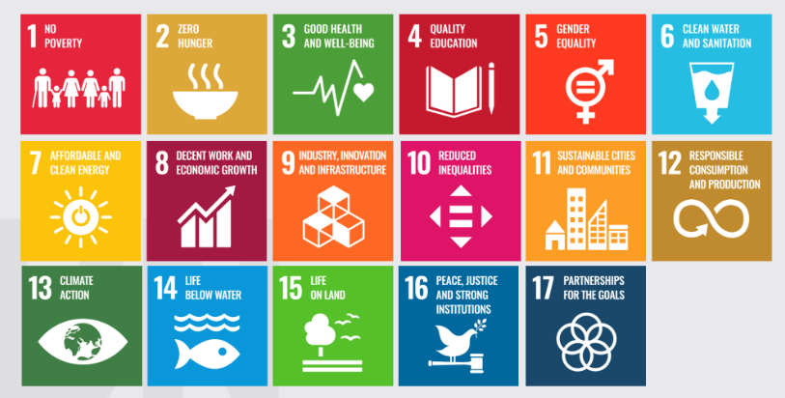
Looking at the Sustainable Development Goals, how many of these themes did you touch on?
Sustainable Development and gender
Notes:
The SDGs outline the goals we are all working on towards 2030. The top line refers to societal equity, the middle refers to cultural infrastructure, the third around nature and populations. A crisis like the one we have outlined takes from all three aspects and, to fix it, we have to pay attention to how we tackle them better.

