Slide 1


Churches100 Peace Appeal Centenary Lecture
December 2025
Faith for a Warless World
  Ffydd dros
  Fyd Di-ryfel

Slide 2
Craig Owen
Churches100 Peace Appeal Centenary Lecture
December 2025
Heritage Advisor
WCIA | Welsh Centre for International Affairs

Slide 3
Wales’ Temple of Peace
Churches100 Peace Appeal Centenary Lecture
December 2025
Cathays Park, Cardiff

Slide 4
01
02
03
04
05
06
07
1920s Peace Campaigns
The Churches Memorial
Mission to America
New York: the Federal Council
Detroit: Congress of Churches
Washington: US Congress
Legacy

Slide 5
Ymgyrchoedd Heddwch y 1920au
Y Gofeb
Cenhadaeth i America
Efrog Newydd
Detroit
Washington
Etifeddiaeth
01
02
03
04
05
06
07
1920s Peace Campaigns
The Memorial
Mission to America
New York
Detroit
Washington
Legacy

Slide 6
1920s Campaigns for Peace & Justice after WW1
Churches100 Peace Appeal Centenary Lecture
December 2025

Slide 7
Women’s Peace Movement
Churches100 Peace Appeal Centenary Lecture
December 2025
Welsh League of Nations Union | WLNU

Slide 8
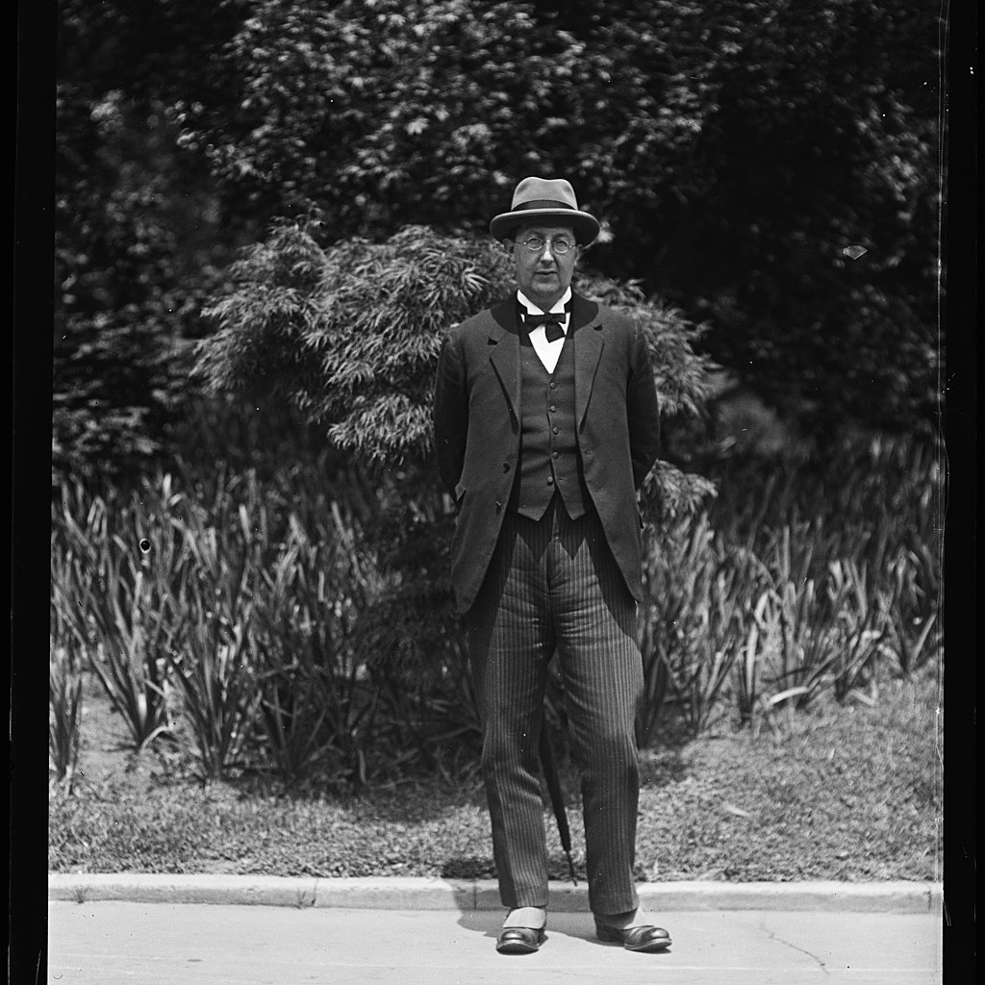
Envisioning a Churches’ Appeal
  Prof Charles Webster of Aberystwyth
League of Nations Assembly in Geneva, September 1924
    Came up with idea of Churches Memorial
    Discussed with Sidney Gulick of US Federal Council
    And Annie Hughes Griffiths of Welsh League of Nations Union

Slide 9
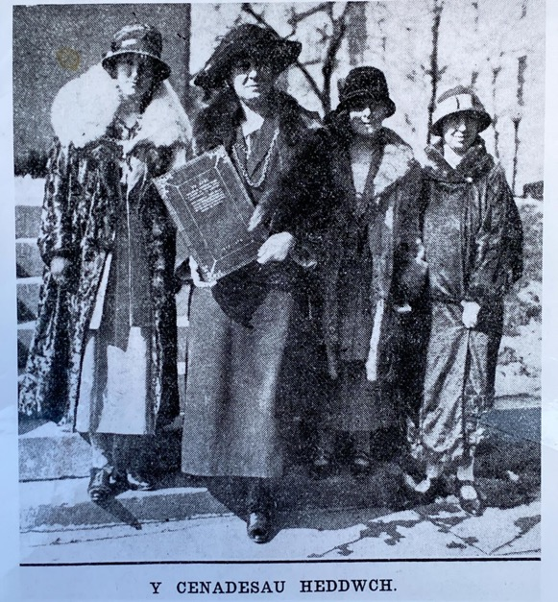
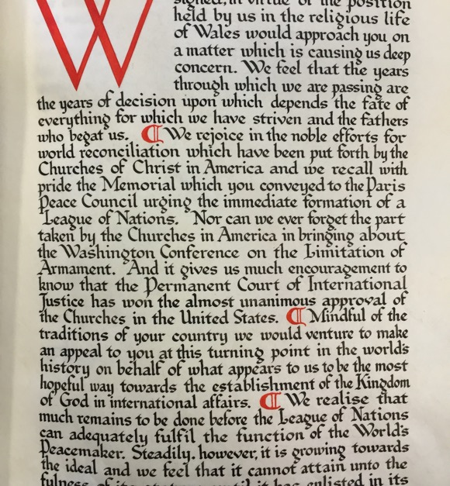
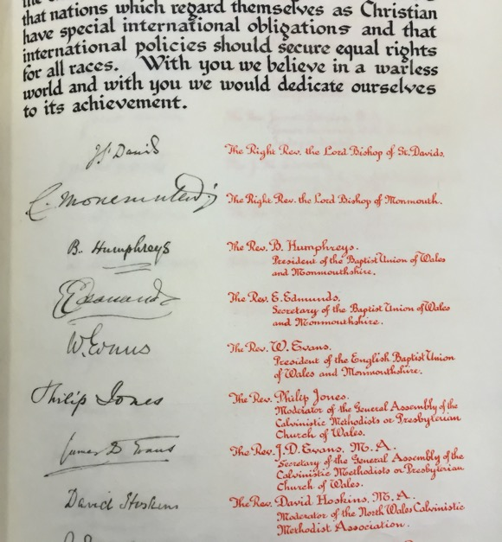
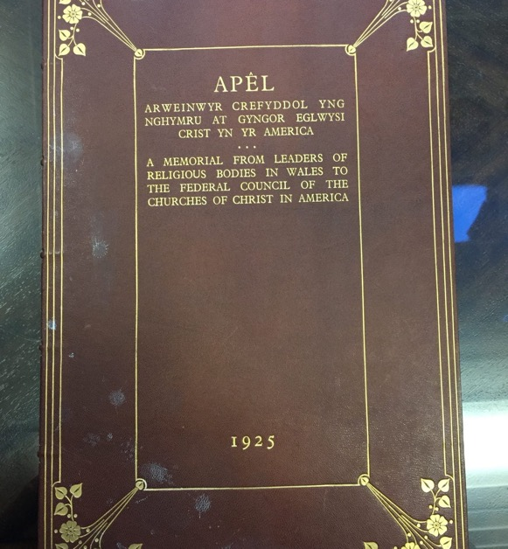
The Campaign
  Countdown to Congress
The whole campaign was drawn together in just 3 months, between the Sept 1925 League of Nations Assembly in Geneva, and the December 1925 gathering of the US Congress of Churches in Detroit. Led by Rev Gwilym Davies, with fundraising support of
League Assembly, Geneva
  Prof Webster, Annie Hughes Griffiths & Sidney Gulick
The Declaration
  Drawn up by the WEAC
The Signatories
  Gathered by Correspondence
The Memorial
  Crafted by Welsh School of Arts & Crafts

Slide 10
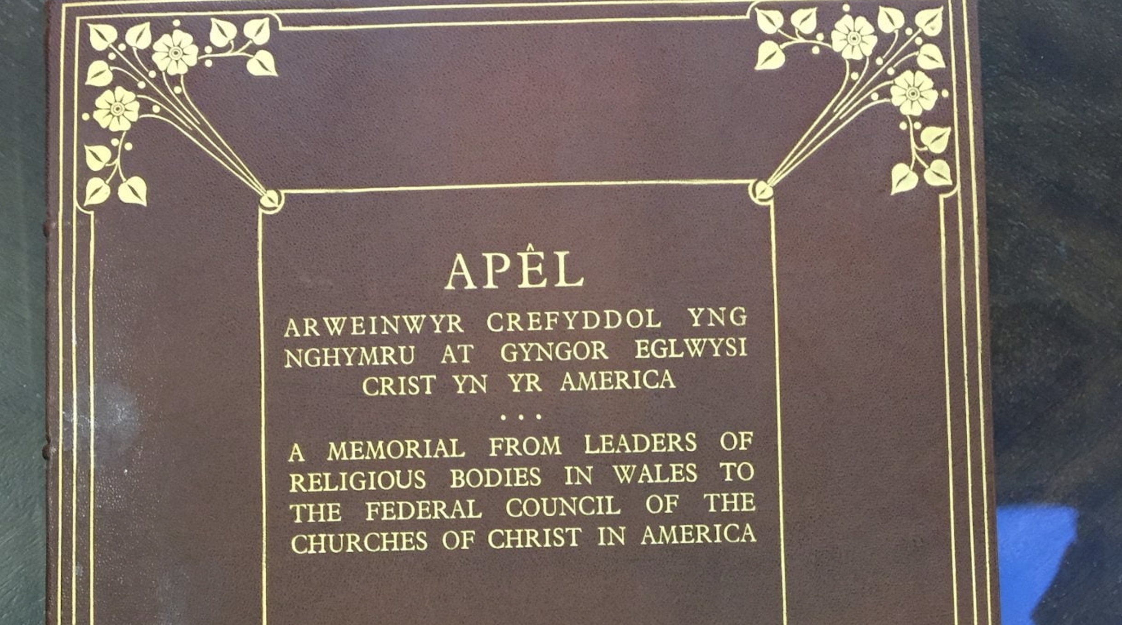

Slide 11
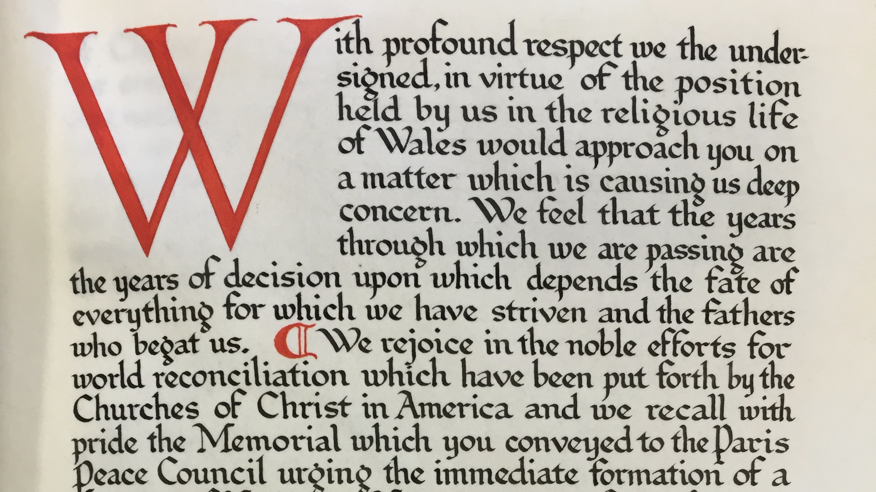
View Declaration online

Slide 12
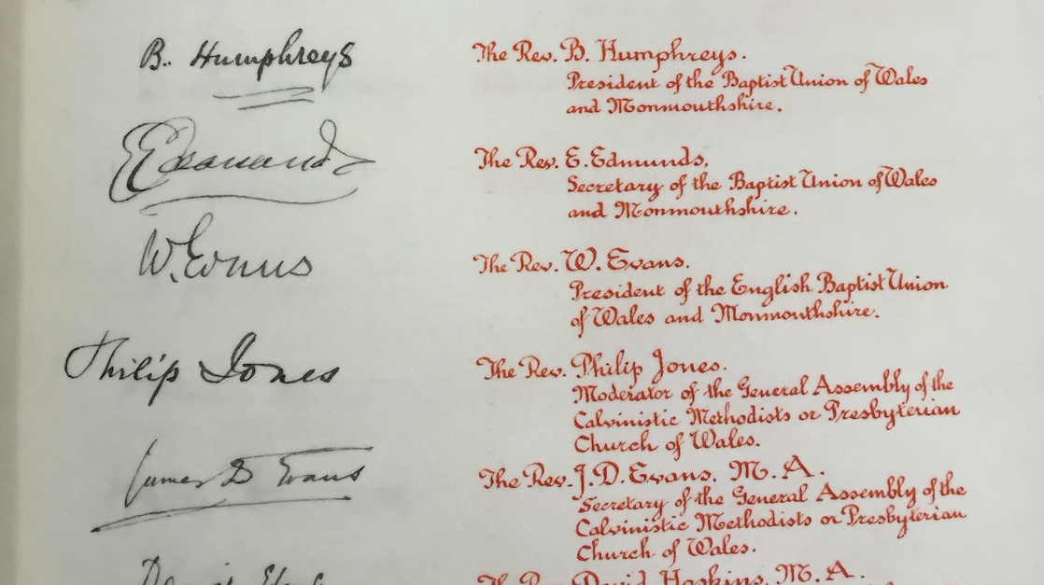
View Signatories online

Slide 13
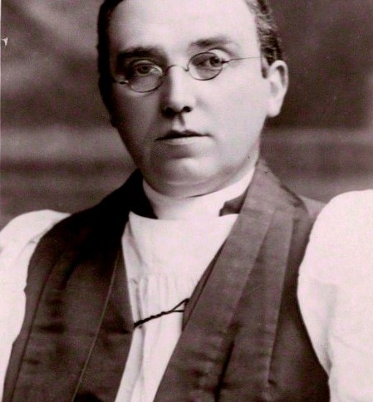
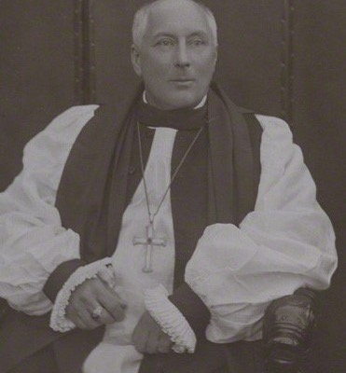
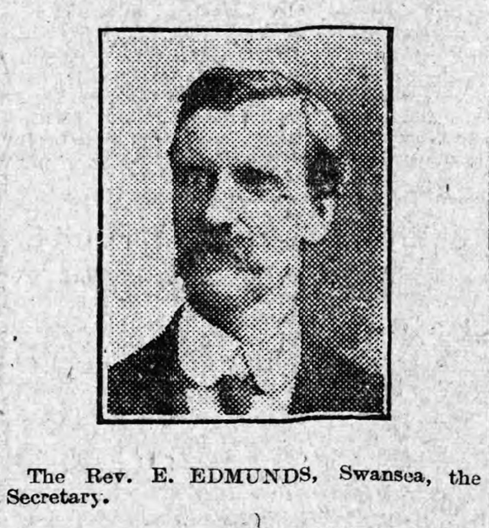
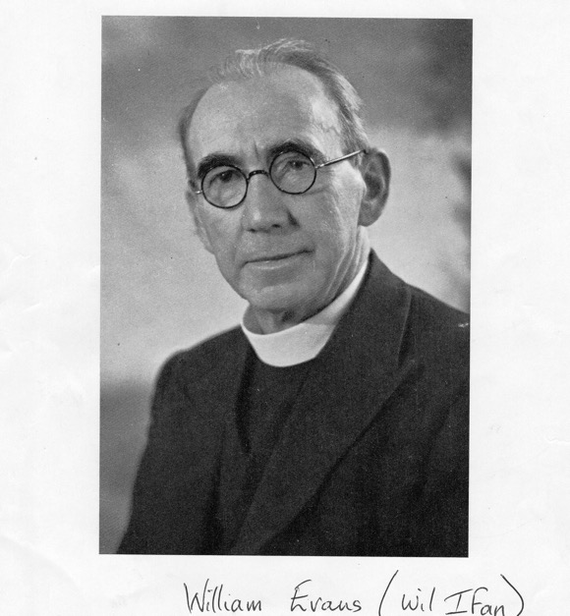
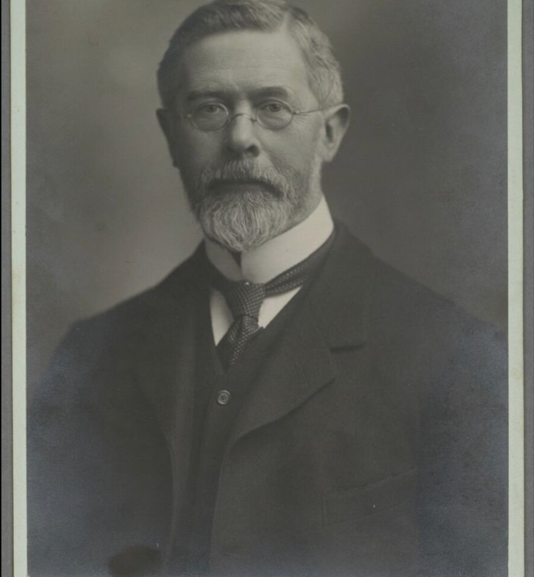
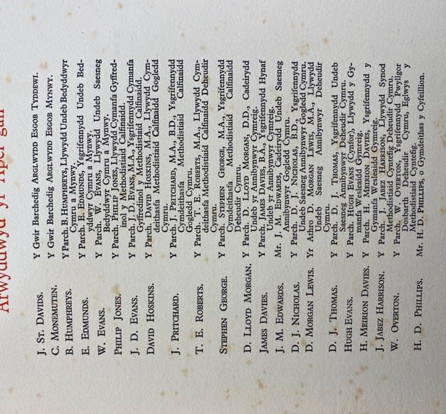
Signatories
  1925 Leaders of Religion in Wales
Of the 22 signatories, we have so far found 5 Portraits:
John Owen, Bishop of St David’s
Charles Green, Bishop of Monmouth
Rev E Edmunds, Baptists Union of Wales & Mon
Will Ifan, Baptists Union of Wales & Mon
Pro D Morgan Lewis, South Wales English Congregational Union

Slide 14
“With you, we believe in equal rights for all races… with you, we believe in a warless world… and with you, we would dedicate ourselves to its achievement.”
Welsh Churches Peace Memorial 1925
  Declaration Statement

Slide 15
Postcards from a 1925
Peace Mission
Document Title
  October 2025
1925 Diary of the Rev Gwilym Davies

Slide 16
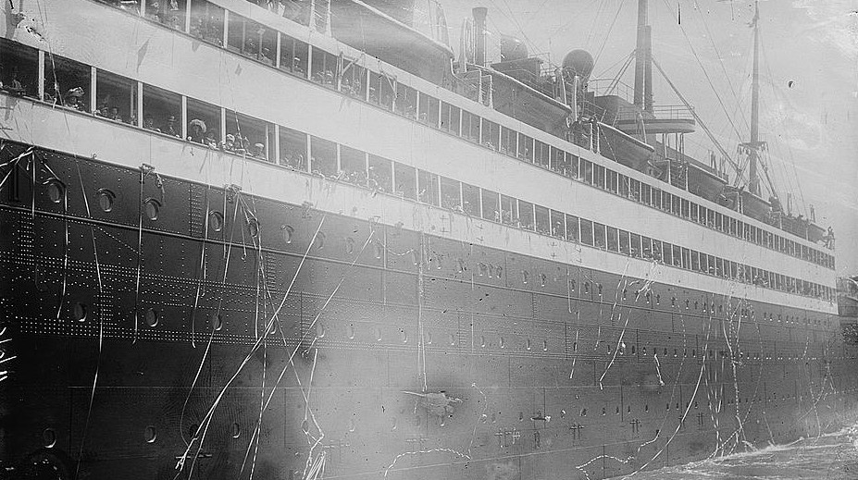
Southampton
Document Title
  October 2025
1925 Diary of the Rev Gwilym Davies

Slide 17
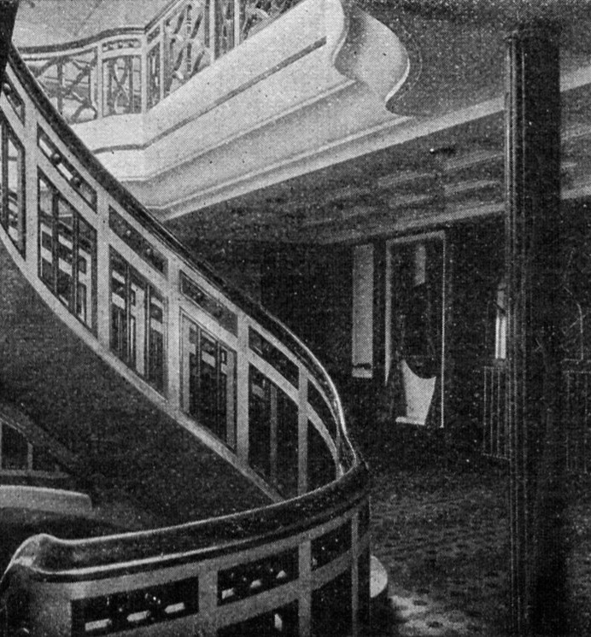
The SS George Washington
  of Paris Peace Conference
“The choice of the George Washington was fortunate. It was in the Presidential Suite of this ocean liner that [WW1 US President] Woodrow Wilson came to Europe to attend the Paris Peace Conference.”
On the second day out the passengers celebrated American Thanksgiving Day - and as the only Minister on board I was asked to take the Thanksgiving Service… This led to a request that I preach at the service in the first class saloon the folllowing Sunday. a chance not to be missed of sowing the good seed [of peace] in mid ocean."

Slide 18
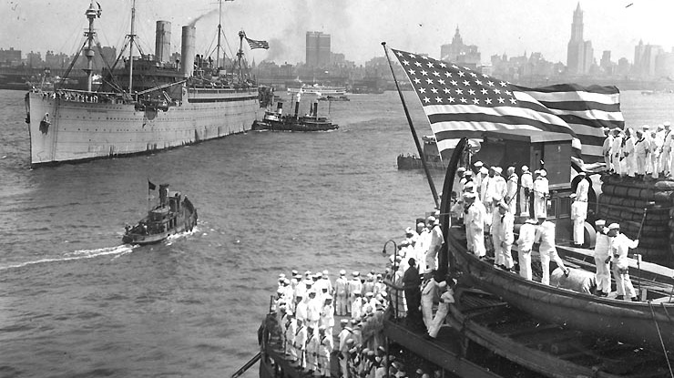
SS George Washington
Document Title
  October 2025
1925 Diary of the Rev Gwilym Davies

Slide 19
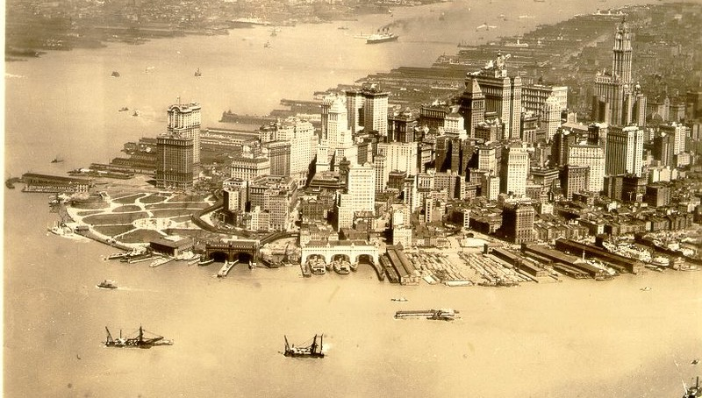
New York City
Churches100 Peace Appeal Centenary Lecture
December 2025
1925 Diary of the Rev Gwilym Davies

Slide 20
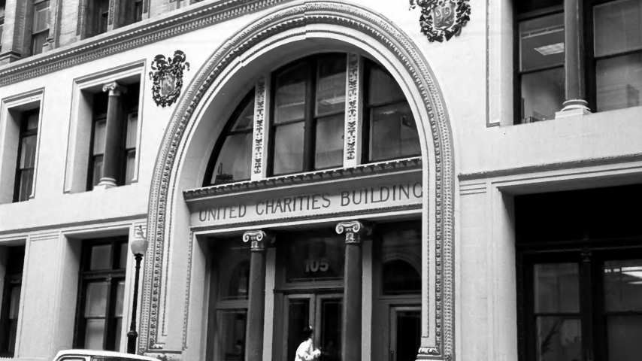
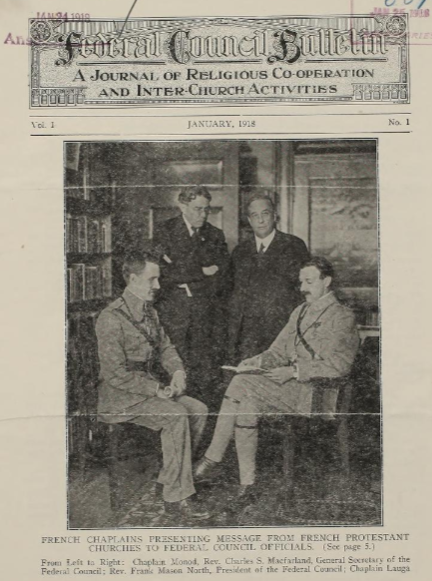
Federal Council HQ,
Flatiron District
Churches100 Peace Appeal Centenary Lecture
December 2025
1925 Diary of the Rev Gwilym Davies

Slide 21
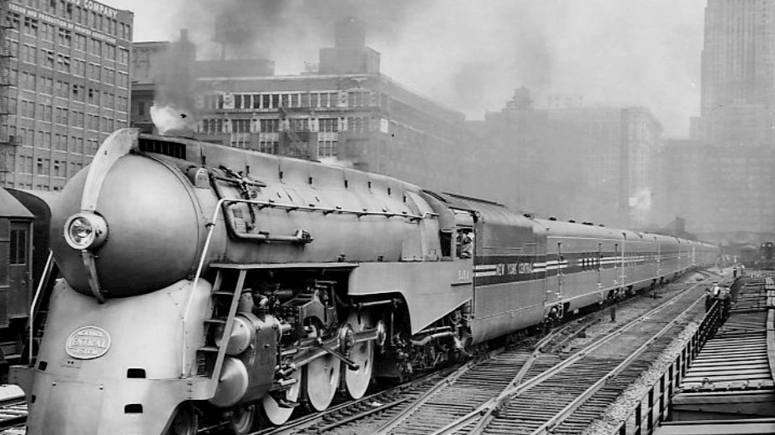
Mission to Michigan: 20th Century Limited
Churches100 Peace Appeal Centenary Lecture
December 2025
1925 Diary of the Rev Gwilym Davies

Slide 22
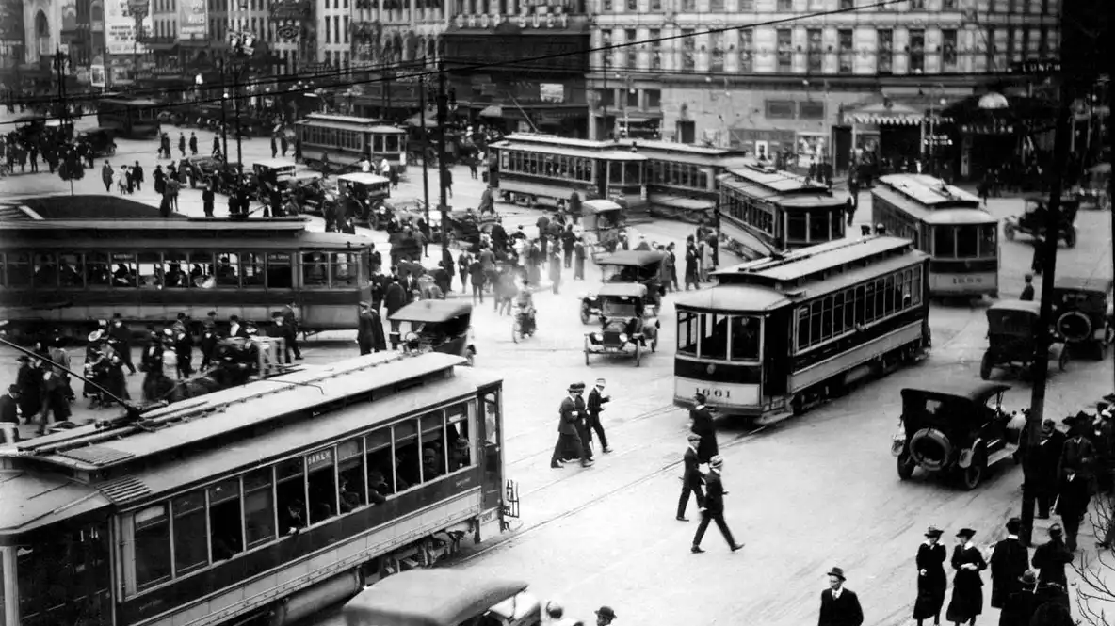
Detroit
Churches100 Peace Appeal Centenary Lecture
December 2025
1925 Diary of the Rev Gwilym Davies

Slide 23
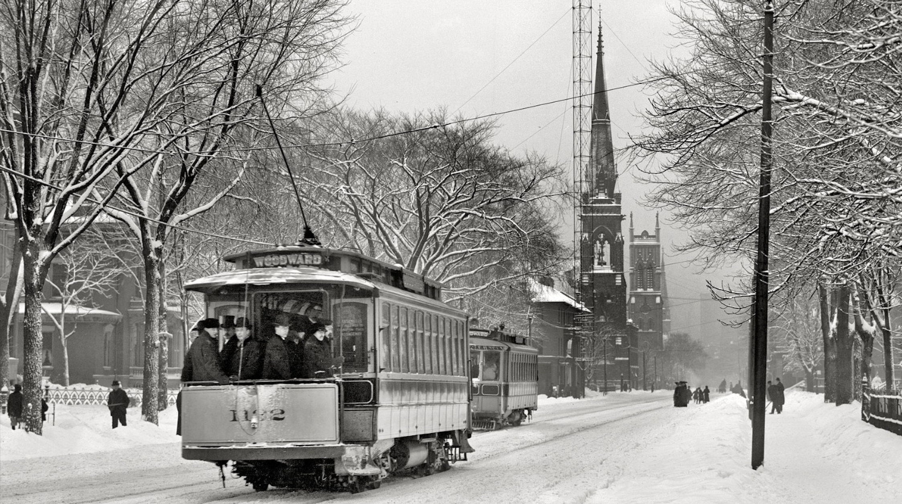
Congress @ Woodward
Avenue Baptist Church
Churches100 Peace Appeal Centenary Lecture
December 2025
1925 Diary of the Rev Gwilym Davies

Slide 24
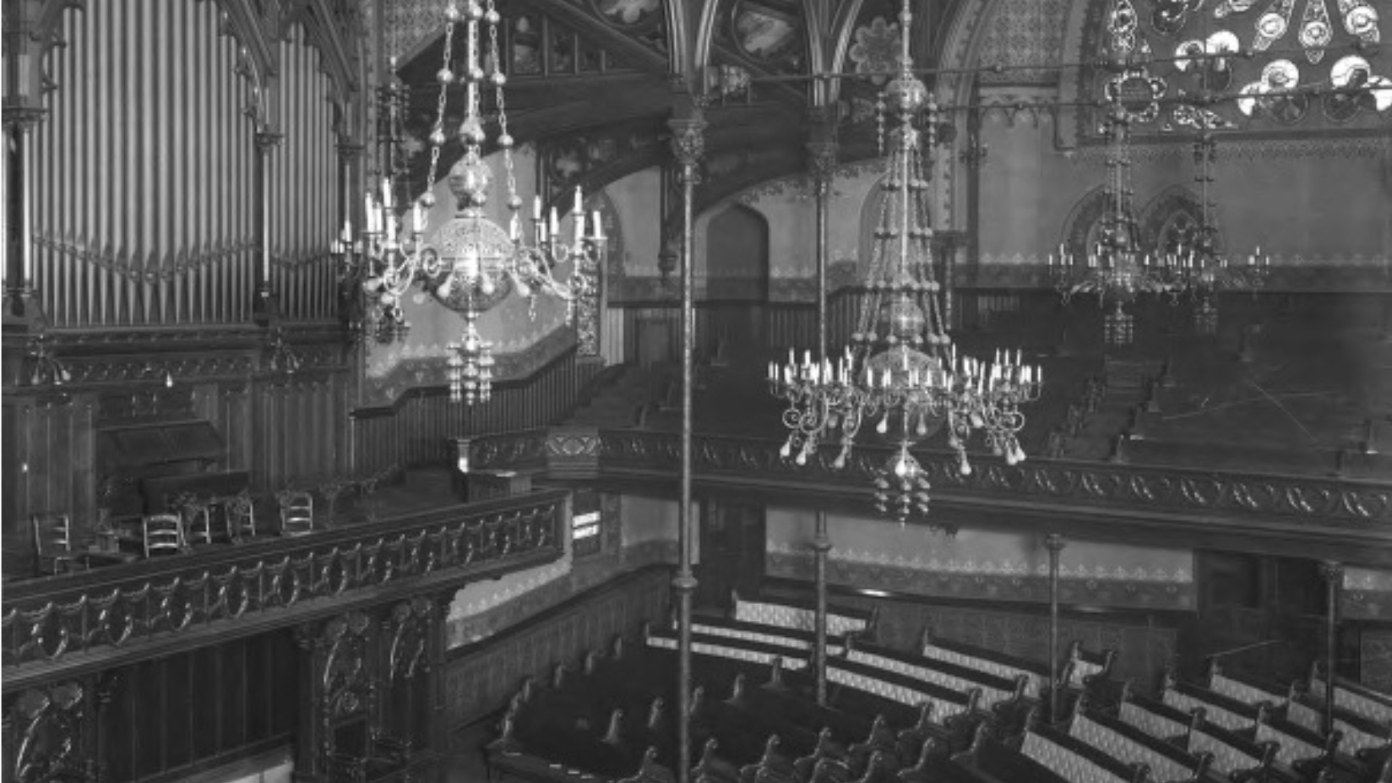
Wales’ Address to the US
Churches100 Peace Appeal Centenary Lecture
December 2025
1925 Diary of the Rev Gwilym Davies

Slide 25
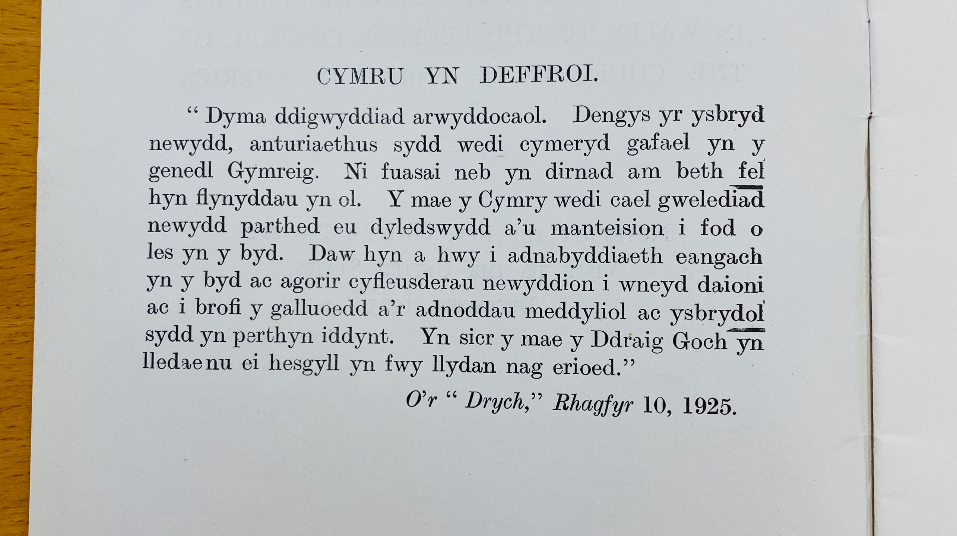
Response
Document Title
  October 2025
1925 Diary of the Rev Gwilym Davies

Slide 26
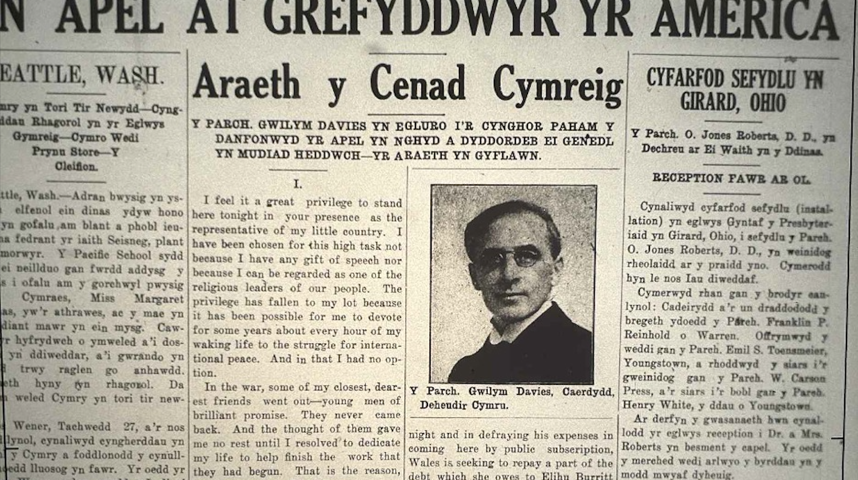

Slide 27
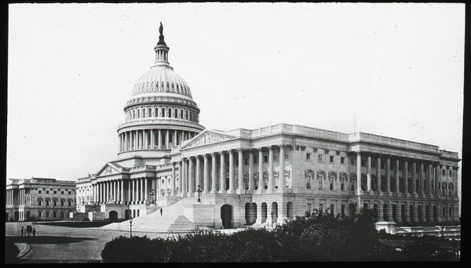
Washington
Document Title
  October 2025
1925 Diary of the Rev Gwilym Davies

Slide 28
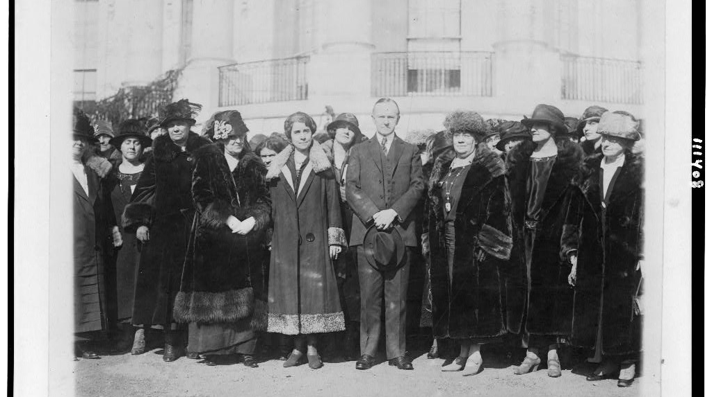
President Calvin Coolidge
Churches100 Peace Appeal Centenary Lecture
December 2025

Slide 29
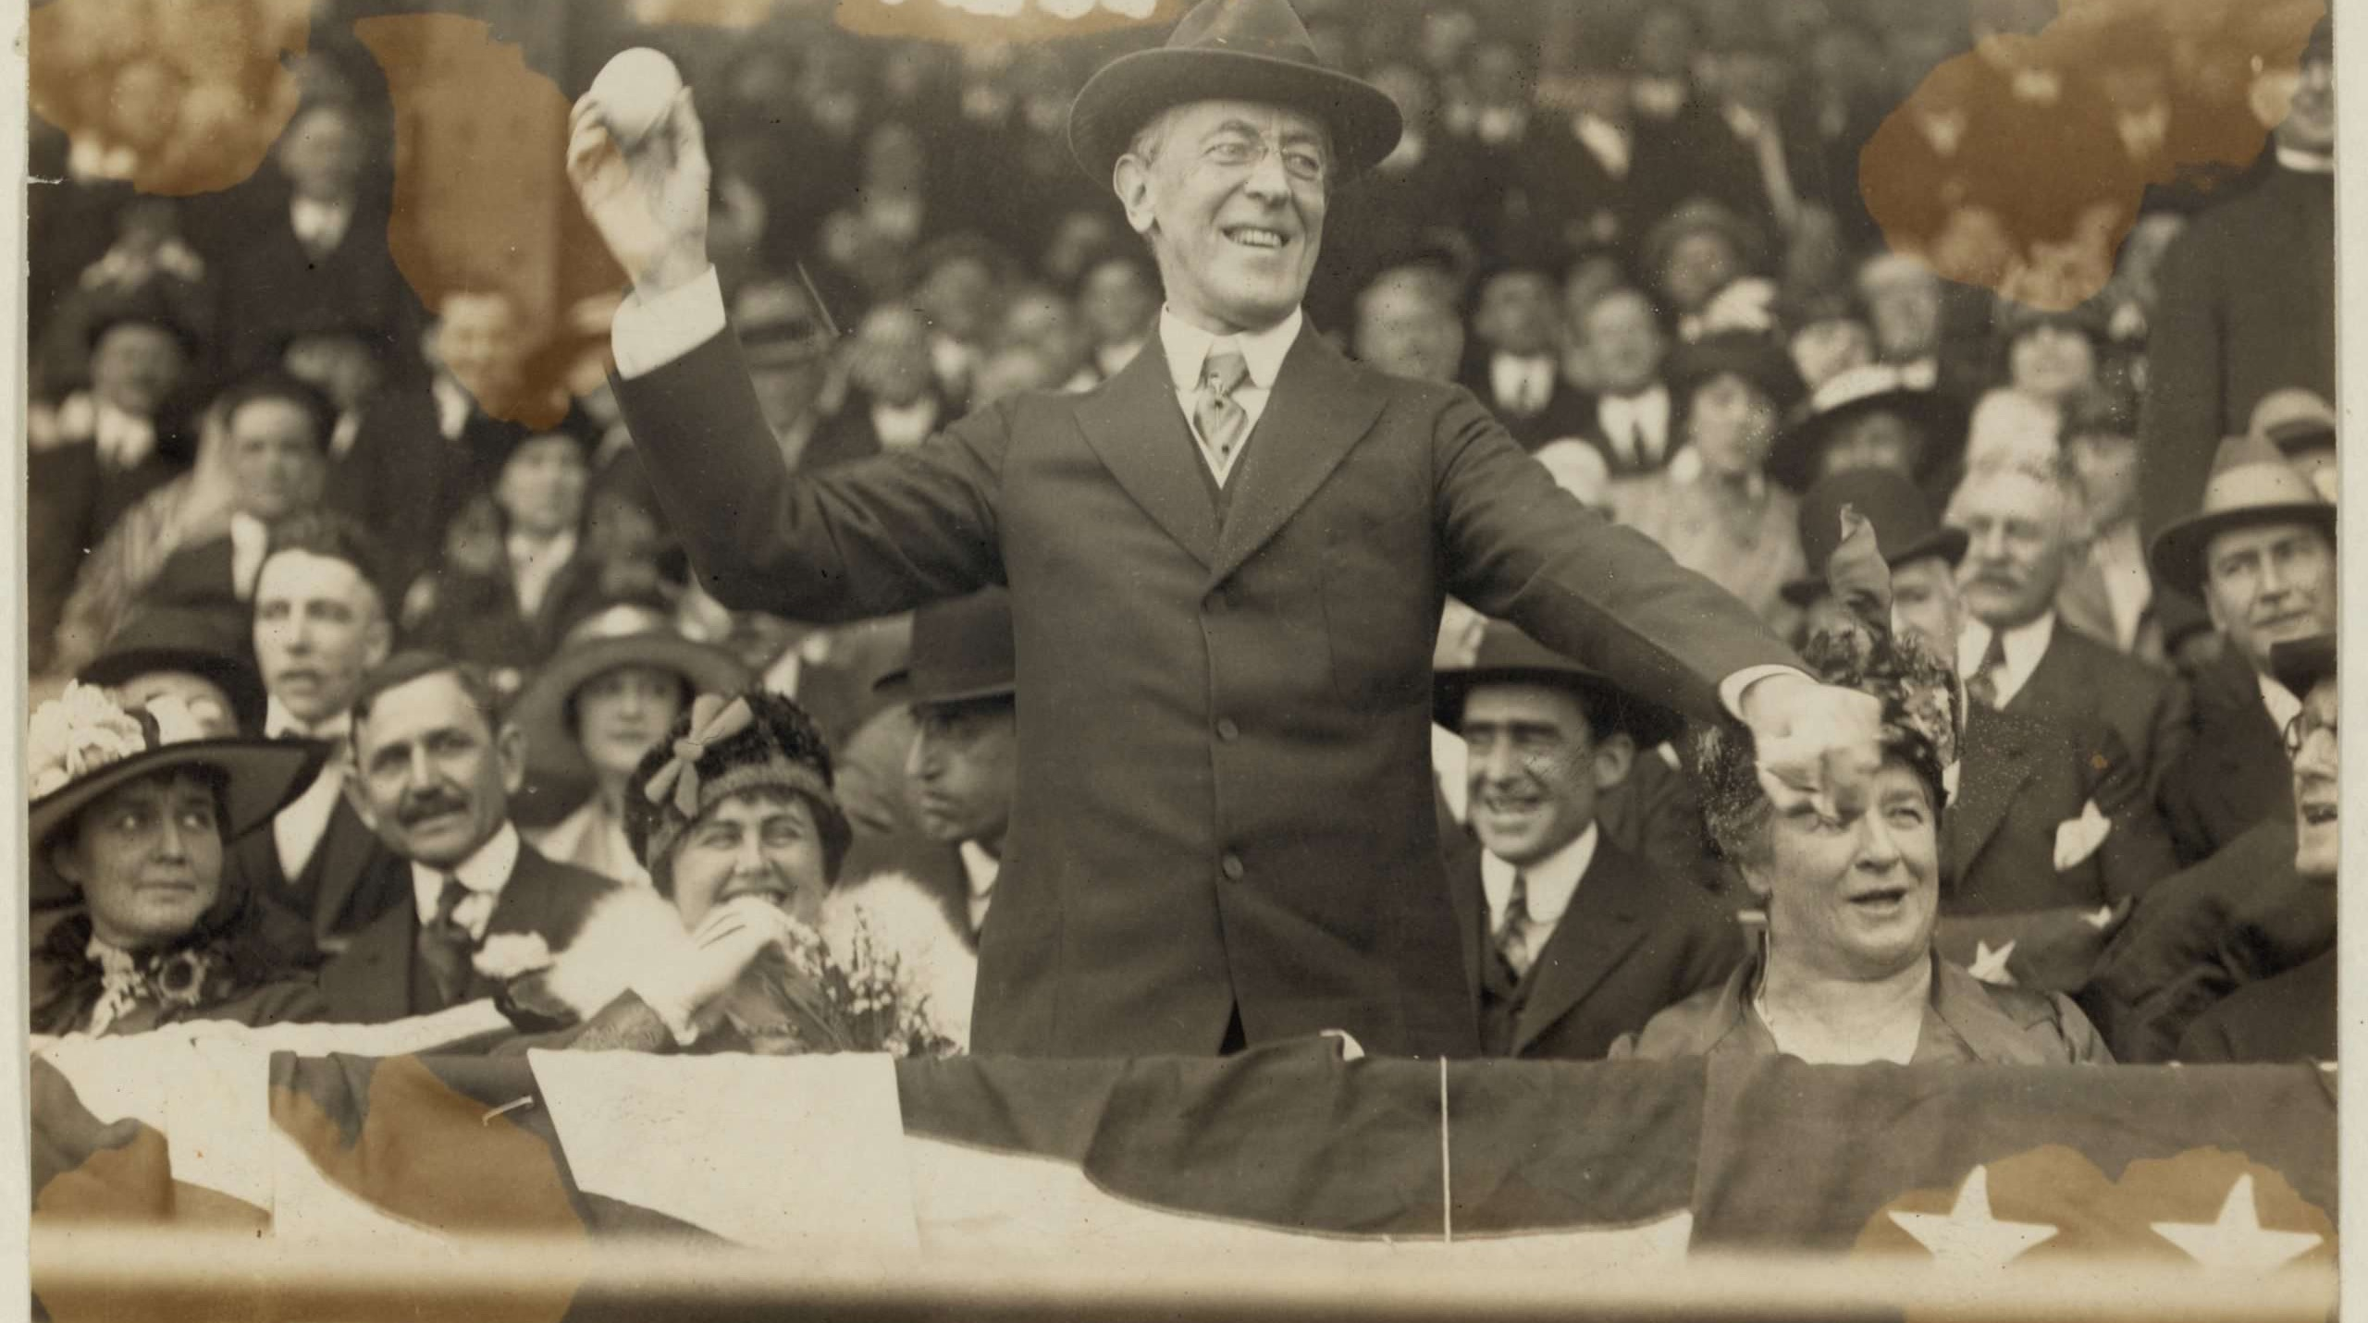
Woodrow Wilson Dinner
Churches100 Peace Appeal Centenary Lecture
December 2025
1925 Diary of the Rev Gwilym Davies

Slide 30
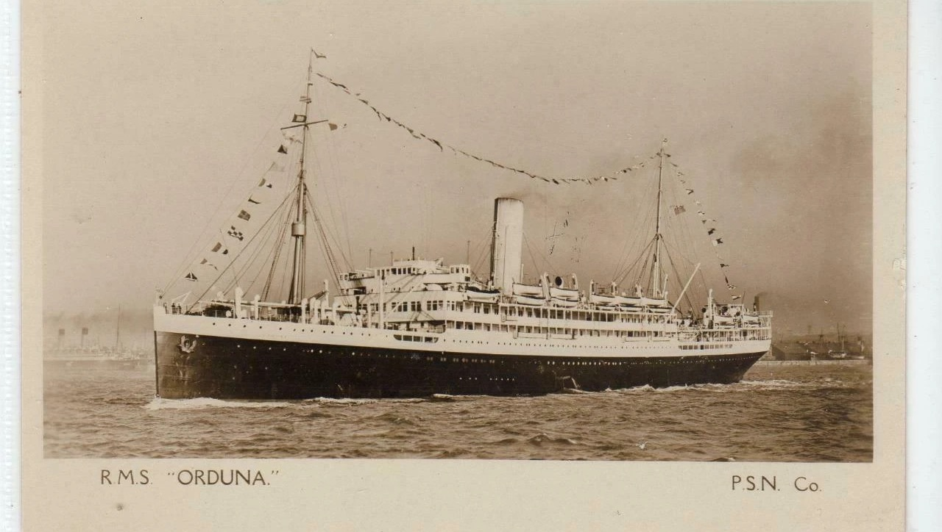
Voyage Home SS Orduna
Churches100 Peace Appeal Centenary Lecture
December 2025
1925 Diary of the Rev Gwilym Davies

Slide 31
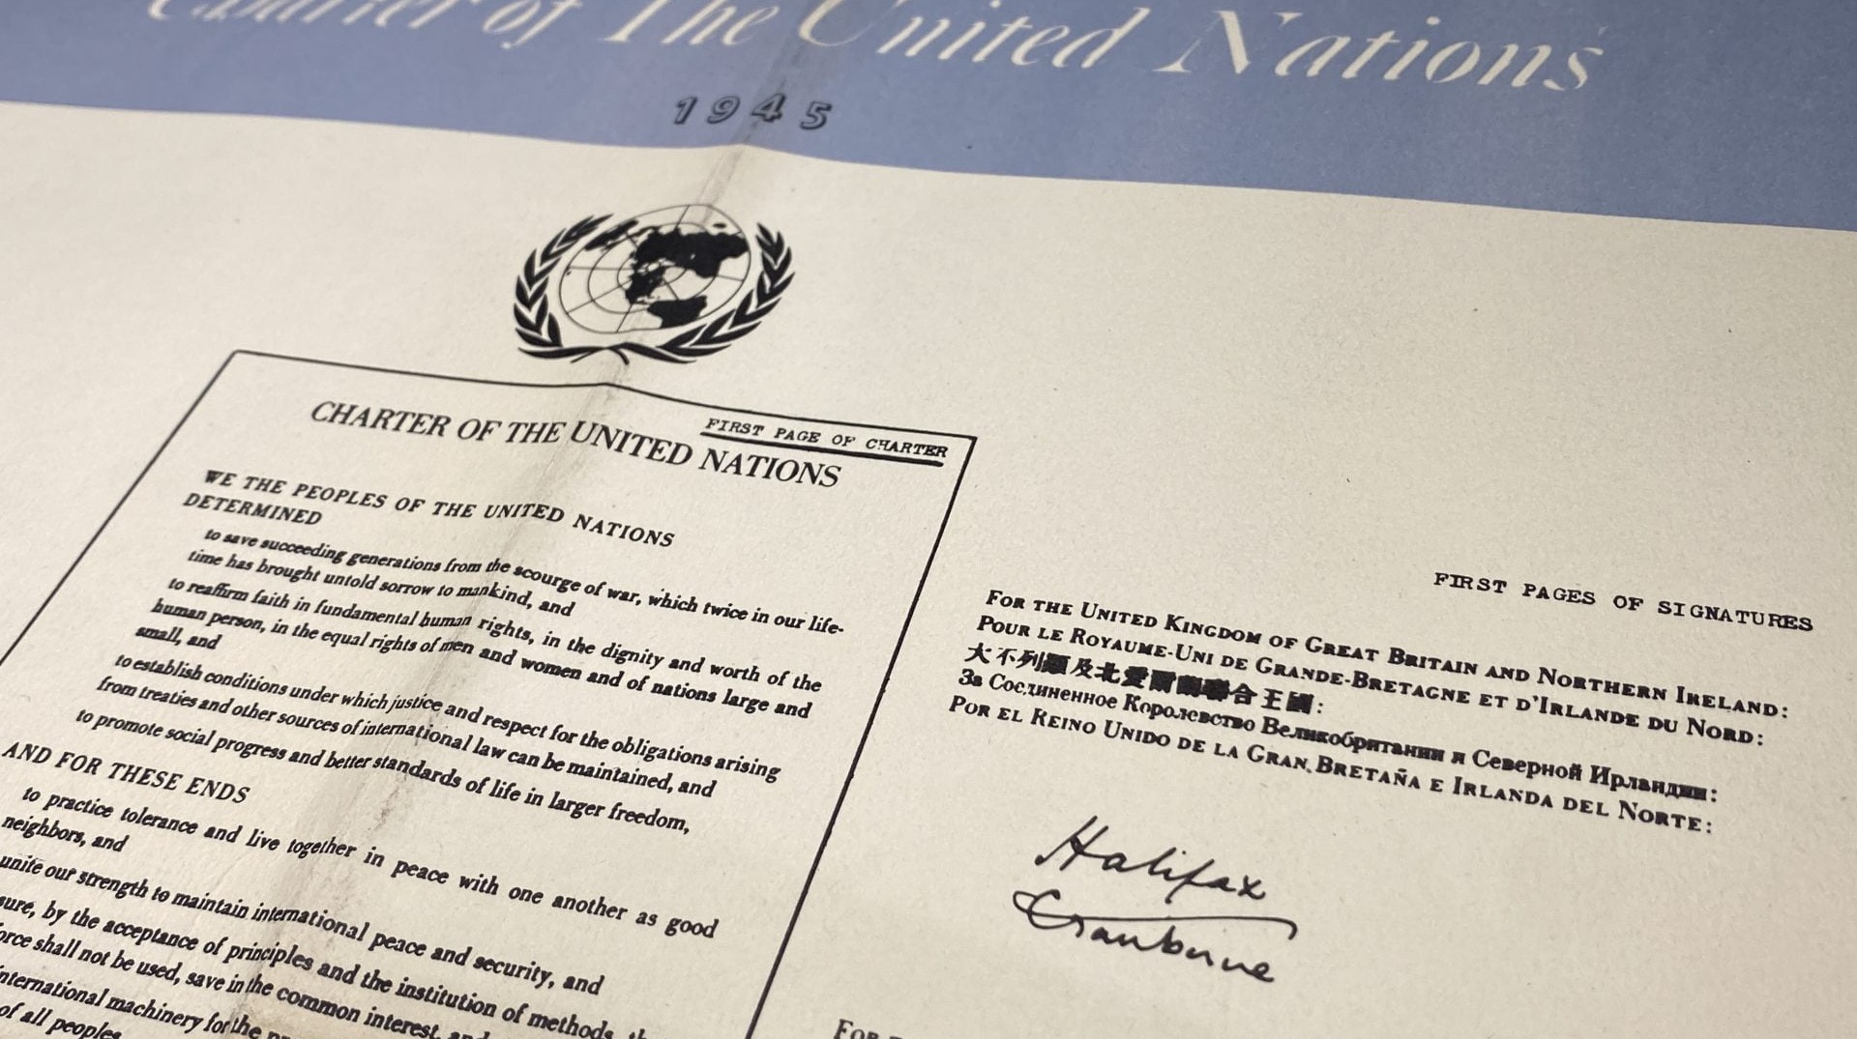
Legacy – Uniting Nations
Churches100 Peace Appeal Centenary Lecture
December 2025

Slide 32
Future Generations: Conversations for Peace
Churches100 Peace Appeal Centenary Lecture
December 2025

Slide 33
Diolch.
  Thank you.
Contact
  Craigowen@wcia.org.uk
  heddwch.cymru

Slide 34
Catrin
Diolch yn fawr iawn Craig ac Eirlys a llongyfarchiadau am barhau i ymchwilio'r mudiadau hyn gan daflu mwy o oleuni ar rai o'r prif gymeriadau o Ddeiseb Heddwch 2024. Hynod ddiddorol a phwysig.
Gethin
Hyfryd gweld yr holl waith hanesyddol a meddyliol sydd wedi digwydd ers i mi ymadael fis Ebrill - diolch i bawb am y cyfan. Rydym mewn cyfnod tebyg i'r 1920au lle mae heddwch yn bwysicach nag erioed, ond y llif gwleidyddol fel petai i'n herbyn. Dylai'r ffaith nad ymatebion negyddol 1924-5 oedd diwedd y stori ein hysbrydoli ni hefyd, er efallai mai'r genhedlaeth nesaf fydd yn elwa yn y pen draw.
Bethan
Seminar mor ddiddorol - diolch i bawb am eu cyfraniadau ac ymchwil.
Catrin
Thank you very much Craig and Eirlys and congratulations for continuing to investigate these movements shedding more light on some of the main characters of the Peace Petition 2024. Very interesting and important.
Gethin
Great to see all the historical and mental work that has taken place since I left in April - thanks to everyone for it all. We are in a period similar to the 1920s where peace is more important than ever, but the political tide seems to be against us. The fact that the negative reactions of 1924-5 were not the end of the story should also inspire us, although perhaps the next generation will ultimately benefit.
Bethan
Such an interesting seminar - thanks to everyone for their contributions and research.
Feedback

Slide 35

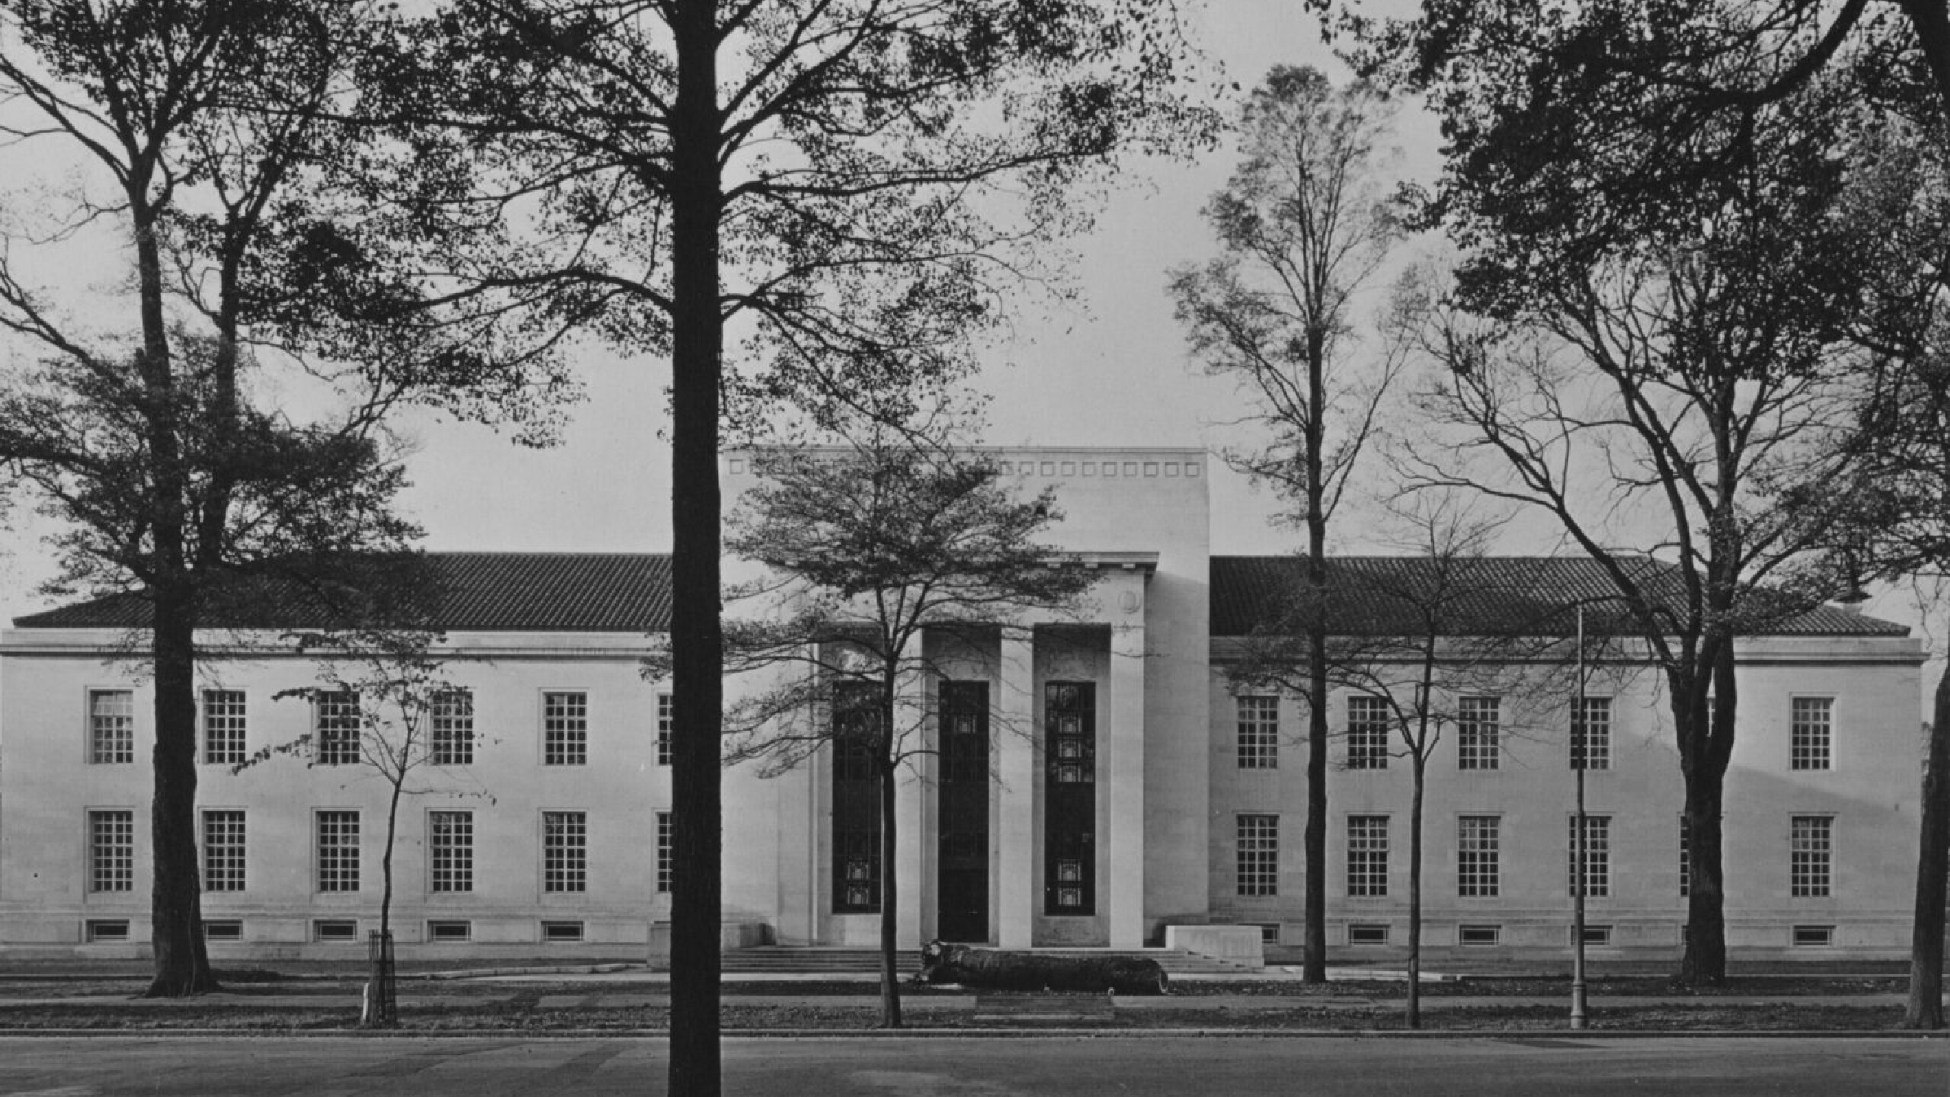
2-image layout with text
Here is an example of a plain slide with 2 images, and an explanatory caption. I think this text is too small to read though (it is font size 36), so…
… this font size (60) may be more user-friendly!

Slide 36
This 2-image option includes image captions
2-image caption
Here is an example of a plain slide with 2 images, and an explanatory caption. I think this text is too small to read though (font size 36), so…
… this font size (60) may be more user-friendly!

Slide 37
12 image slide – very unreadable captions! May be good for handouts
Here is an example of a plain slide with 2 images, and an explanatory caption. I think this text is too small to read though (it is font size 10), so…
… this font size (22) may be more user-friendly!
2-image layout with text

